Slide 1
Food Price Volatility, Trade and Food Security
Will Martin
World Bank
The views expressed in this presentation are those of the author only and not necessarily those of the World Bank

Slide 2
Issues
Why do high and volatile prices matter?
What makes sense for individual countries?
The collective action problem
Potential policies to mitigate the problem

Slide 3
Food price volatility
Shocks to output are the major source
These may get worse with global warming
Shocks to demand from--for instance--biofuels, may also contribute
Globalization can help reduce price volatility by diversifying sources of supply
Likely to be part of the solution
rather than a problem

Slide 4
Impacts depend on stock levels
If stocks are normal, adverse shocks can be absorbed by stock reduction
Key problems arise when stocks are low
Reducing demand in line with supply requires large increases in price
Prices spend long periods in the doldrums punctuated by short but intense price spikes

Slide 5
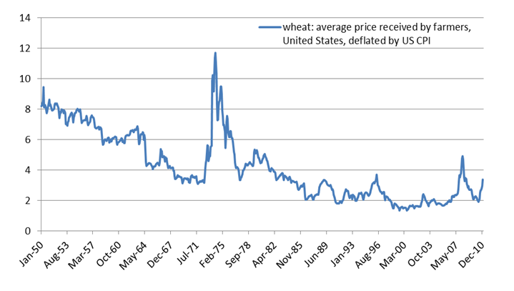
Real wheat prices
Source: USDA. Deflated using U.S. CPI

Slide 6
Impacts of food prices on the poor
Poorest spend 75% of income on staple foods
3/4 of poor people are rural & earn most of their income from farming
Poor farmers don’t gain much from higher prices
Many are net buyers of staple foods
Little opportunity to increase output in response to higher prices
Net impacts on poverty?
Are the gains to poor net sellers outweighed by the losses to poor net buyers?

Slide 7
Rice & wheat prices, $US

Slide 8
Poverty Impacts: 2005-8 price rise
Used data on household production, purchases & sales of major staple foods and sales of unskilled labor
Household survey data for ten low-income country-periods
Bolivia, Cambodia, Madagascar, Malawi, Nicaragua, Pakistan, Peru, Vietnam (98,04), Zambia
Used World Bank $1 per day poverty rates
Estimated that the 2005-8 price rises put 100 million into poverty

Slide 9
2010-11 price surge
Primarily June to December 2011
Wheat, maize, many other commodities
But fortunately not rice
Much less likely that wages have responded
Used detailed data on the extent of pass-through into domestic prices
Data on 28 countries & 38 commodities
Estimate that 44 million have been pushed below the $1.25/day poverty line
68 million entering poverty; 24m escaping

Slide 10
Poverty impacts by country, % pt

Slide 11
What should poor countries do?
An attractive policy option is to:
Restrict exports when world prices are high
Lower tariffs or pay import subsidies if an importer
Countries are strongly countercyclical with their trade policies
Many raise protection and/or pay export subsidies when prices are low
Historically both industrial & developing countries have insulated in this way

Slide 12
South Asia Rice: Nominal rate of assistance vs World Price: Correlation: -0.754

Slide 13
A potential spiral?
Higher world prices
Export restrictions
Import barrier reductions
Higher world prices
More export restrictions

Slide 14
A collective action problem
If everyone attempts to reduce the impact of world price increases
The policy appears to be a success
“Domestic prices rose less than world prices”
But it is collectively completely ineffective
The world price increases one for one with attempts to lower domestic prices

Slide 15
Like the grandstand problem
When everyone in a crowd stands up to get a better view
No one does if all are the same height
And all those of below-average height lose out
But unilateral refusal to participate doesn’t solve the problem
If I don’t stand up, I get a terrible view!
Unfortunately, insulation against staple food price changes can have more serious consequences

Slide 16
Analyze price rises of 1973-4 & 2005-8
Use World Bank data on distortions to agricultural incentives
Data for 75 countries
Update to 2008
Assess the impacts of rising export barriers, declining import barriers, on world prices

Slide 17
Estimated impacts on world prices
 | Impact of Δ Protn | Share due to Δ Protn
 | % | %
Rice 2005-8 | 46 | 45
Wheat 2005-8 | 28 | 30

Slide 18
Insulation in rich & poor countries
Developed countries have traditionally used insulating policies
Very strongly in 72-4 & 84-86,
But much less in 06-08
WTO disciplines on insulation?
eg ban on variable levies?

Slide 19
2008 surge, rice prices

Slide 20
2008 surge, wheat prices

Slide 21
Insulation policies
Clearly, insulation policies are much less effective than they appear to individual countries
Redistribute, rather than reduce, domestic price volatility
For large countries, such as China, India and Vietnam, the effect is very direct
Export restrictions raise world prices, reducing the effectiveness of the policy
For all countries, the collective action problem remains

Slide 22
Domestic policy options: poor countries
Protecting the poorest is most important
Best to focus on safety-nets for the poorest
rather than trade barriers that reduce incentives to produce, and for the better-off to reduce consumption
May require small, targetted stocks
Help producers in poor countries
Improved technology can help raise incomes and lower poverty in the longer term
Improved access to risk management tools

Slide 23
Domestic policy options: rich countries
Protecting the poorest is important
Safety-net policies better than price distortions
Help producers improve technology
Improved access to risk management tools
Re-examine biofuel policies?
Do they make environmental sense?
Are the resulting price rises sustainable?
Mandates inflexible when food supplies short
Perhaps a call option to preserve food access when food prices are very high?

Slide 24
Questions for international policy
How might cooperative policies improve on the current beggar-thy-neighbor regime?
Would restrictions on export barriers help increase the confidence of importers?
Should food aid be exempted from export bans
Should policies focus just on export barriers?
Or include import barrier reductions?
How might international disciplines on trade and storage policies work?
Convert export restrictions to taxes?
Aim to reduce the degree of insulation?

Slide 25
Conclusions
Prices of staple foods prone to intense but short-lived price spikes
Extremely costly in terms of welfare
Optimal policy for an individual country likely to involve beggar-thy-neighbor policies like export restrictions & import subsidies
But these policies collectively self-defeating
Seem to need new policy rules to deal with the volatility problem
which may be more serious with climate change?

