Slide 1

Cash on Delivery Aid: For Energy Access?
Nancy Birdsall
Energy For All: Financing Access for the Poor
Oslo, Norway
October 11th, 2011

Slide 2
What is COD Aid?
A contract: Donor (DfID/Bill Gates) pays a government $XX for each increment of progress against an agreed outcome
E.g.: $100 for each additional child entering secondary school; each new household with access to water or electricity
Donor pays annually over (at least) 5 years
Notes:
Keep in mind: Short and long-term; accountable government
2

Slide 3
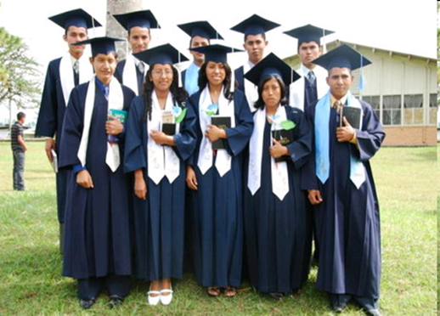
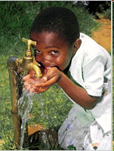
Donor pays annually for outcomes not inputs…
Notes:
3

Slide 4
Key features of
COD Aid
Donor pays for outcomes, not inputs
Govt agreed to independent third-party verification of its annual reports
Donor is hands-off – unless and until asked
Government agrees to full transparency: public knows the contract
Complementarity with other aid programs
Notes:
Keep in mind: Short and long-term; accountable government
4

Slide 5
COD Aid #1: For increased rural access (only off-grid?; only “clean”?) , e.g.:
Malawi government is paid $XX for each new rural household with YY megawatts available
By any process, product, at any price
Via any provider: local private providers, co-ops, local govts; co-generation among households
Creates incentive to fix policy, pricing, financing, other constraints; experiment and adapt; govt can pass on payment to providers
Notes:
Drawn from Savedoff, Incentives proliferation paper

Slide 6
COD Aid #2: For increased urban access
Donor pays Karachi (Pakistan) govt 10% “bonus” on revenue collected against (metered) billings for electricity
Karachi govt supports higher tariffs; peak-loan pricing; pays local power utility itself (!); lobbies central govt on circular debt problem
Innovates on guarantees to wary private investors
Notes:
Drawn from Savedoff, Incentives proliferation paper

Slide 7
COD Aid #3: Paying for Reduced Deforestation
REDD / Norway in Brazil, Indonesia, Guyana
What’s going well
What are the challenges
Going global: Building on FORMA
Notes:
Drawn from Savedoff, Incentives proliferation paper

Slide 8
Some benefits of COD Aid
Makes governments accountable to citizens not outside donors
Expertise from outside (“technical assistance”) is demand- not supply-driven
Can leverage non-public money
Allows for experimenting, failing, learning
Can work where governments weak – and help to strengthen them
Notes:
Nancy: Note, #1 is the most important thing. May delete from this slide if you feel you’ve focused on it enough throughout the presentation

Slide 9
Why ?: The enabling environment
Problem is not technical or ROI but political and “policy” risk (pricing/local govt monopoly)
Problem is not “capacity” but system dysfunction in low-income countries
Institutional change (“enabling government”) takes time; outsiders cannot do it
Donor money is scarce – needs to be leveraged too!
Notes:
Taken from Bill’s slides on water and sanitation for Gates conference.

