Slide 1

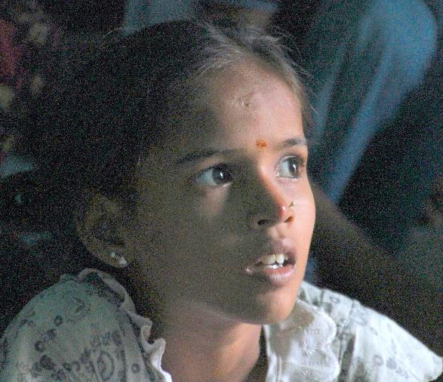
Scaling Up
in Development:
Lessons from Pratham
Center for Global Development
Washington DC
October 29 2013

Slide 2
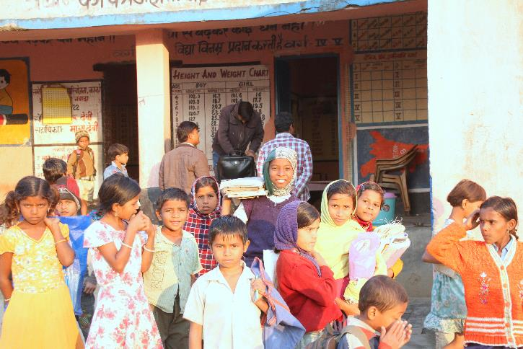
July 2012: “Feeling” the problem
SITUATION ON THE GROUND in JEHANABAD DISTRICT IN BIHAR
High enrollment (96%+ ASER 2012)
Low attendance (around 70%)
High “entitlements” (scholarships, cycles etc)
Total public expenditure on elementary education in Bihar :
2010-11: USD 1.2 billion
2012-13: USD 2.3 billion
(Data from Accountability Initiative)
Government Primary school. Jehanabad district. Bihar.

Slide 3
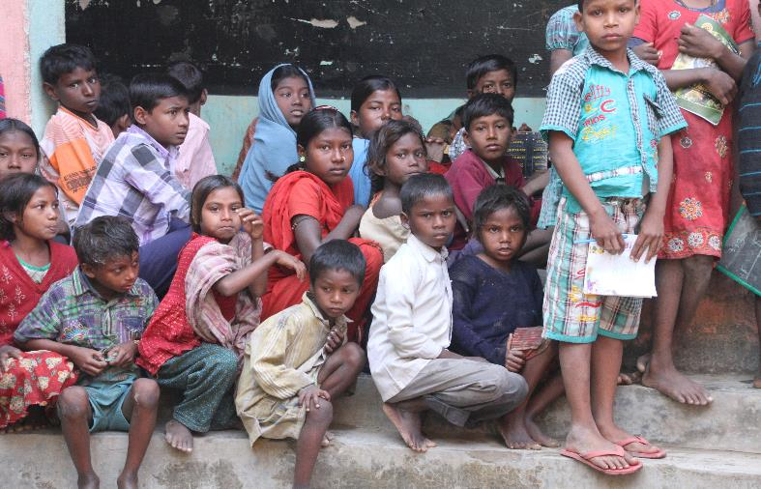
Where is the problem? Why are we “stuck”?
Pratham’s analysis of the teaching-learning situation in India:
Grade level teaching is leaving children behind. This leads to frustration for teachers, disinterest among children and demotivation among parents.

Slide 4
Exploring the problem
We suggested that there is a structural problem - children are several grade levels behind ….
The district administration decided to “test” this hypothesis for themselves to understand exactly what the problem was ..
Within a few days, the district had generated their own data for themselves from a quick assessment in 10 government primary schools.
July 2012 : % Children getting marks at different levels on a test at Grade II level Conducted by district administration
Grade | Total Tested | A | B | C
Maths
V | 311 | 35.7 | 28.0 | 36.3
IV | 314 | 57.3 | 30.9 | 11.8
III | 259 | 58.3 | 29.3 | 12.4
Total | 884 | 50.0 | 29.4 | 20.6
Language - Hindi
V | 320 | 48.4 | 21.3 | 30.3
IV | 309 | 57.9 | 26.5 | 15.5
III | 200 | 28.0 | 46.0 | 26.0
Total :- | 829 | 47.0 | 29.2 | 23.8
District administration’s own assessment July 2012

Slide 5
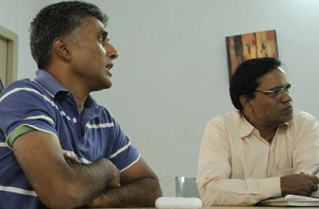
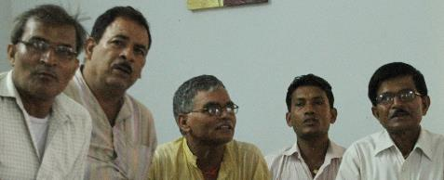
Planning forward … building ownership
District suggested – a pilot in 250 schools. The plan was to
first build a team from within the government which could
“lead”. If this team was “converted” then
we continue, otherwise not.
CRCCs (Cluster Resource Centre Coordinators) were selected
to be the leaders. Each with 12-15 schools under them. So far
had been involved in inputs and “inspections” . Challenge was to convert them into “owners” and teaching-learning “leaders”.
CRCCs came for 3 day training.
Day 1 - “Aha” moment !!!!!
Next 2 days practice in nearby schools.
District administrator & District Education Officer
CRCCs

Slide 6
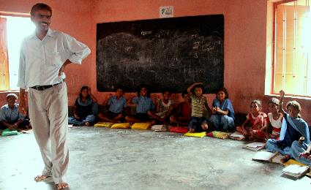
Nuts & bolts : “Plumbing matters”
Target children : Grade 3, 4 and 5 all children.
Special time during the school day – 1.5 hours at the end of the day
Assess all children in Grade 3-5 with simple reading tool
Group children for instruction by reading level rather than by grade
Focus on building basic reading skills using simple reading materials and methods
CRCC PRACTICE CLASSES : For 15 continuous days CRCCs practised this model in their schools. 3 CRCCs per school worked with 3 groups of children (On average this district has 3 teachers per school). At the end of the “practice period” program was reviewed. Only then the decision was taken to “scale up” to 250 schools.

Slide 7
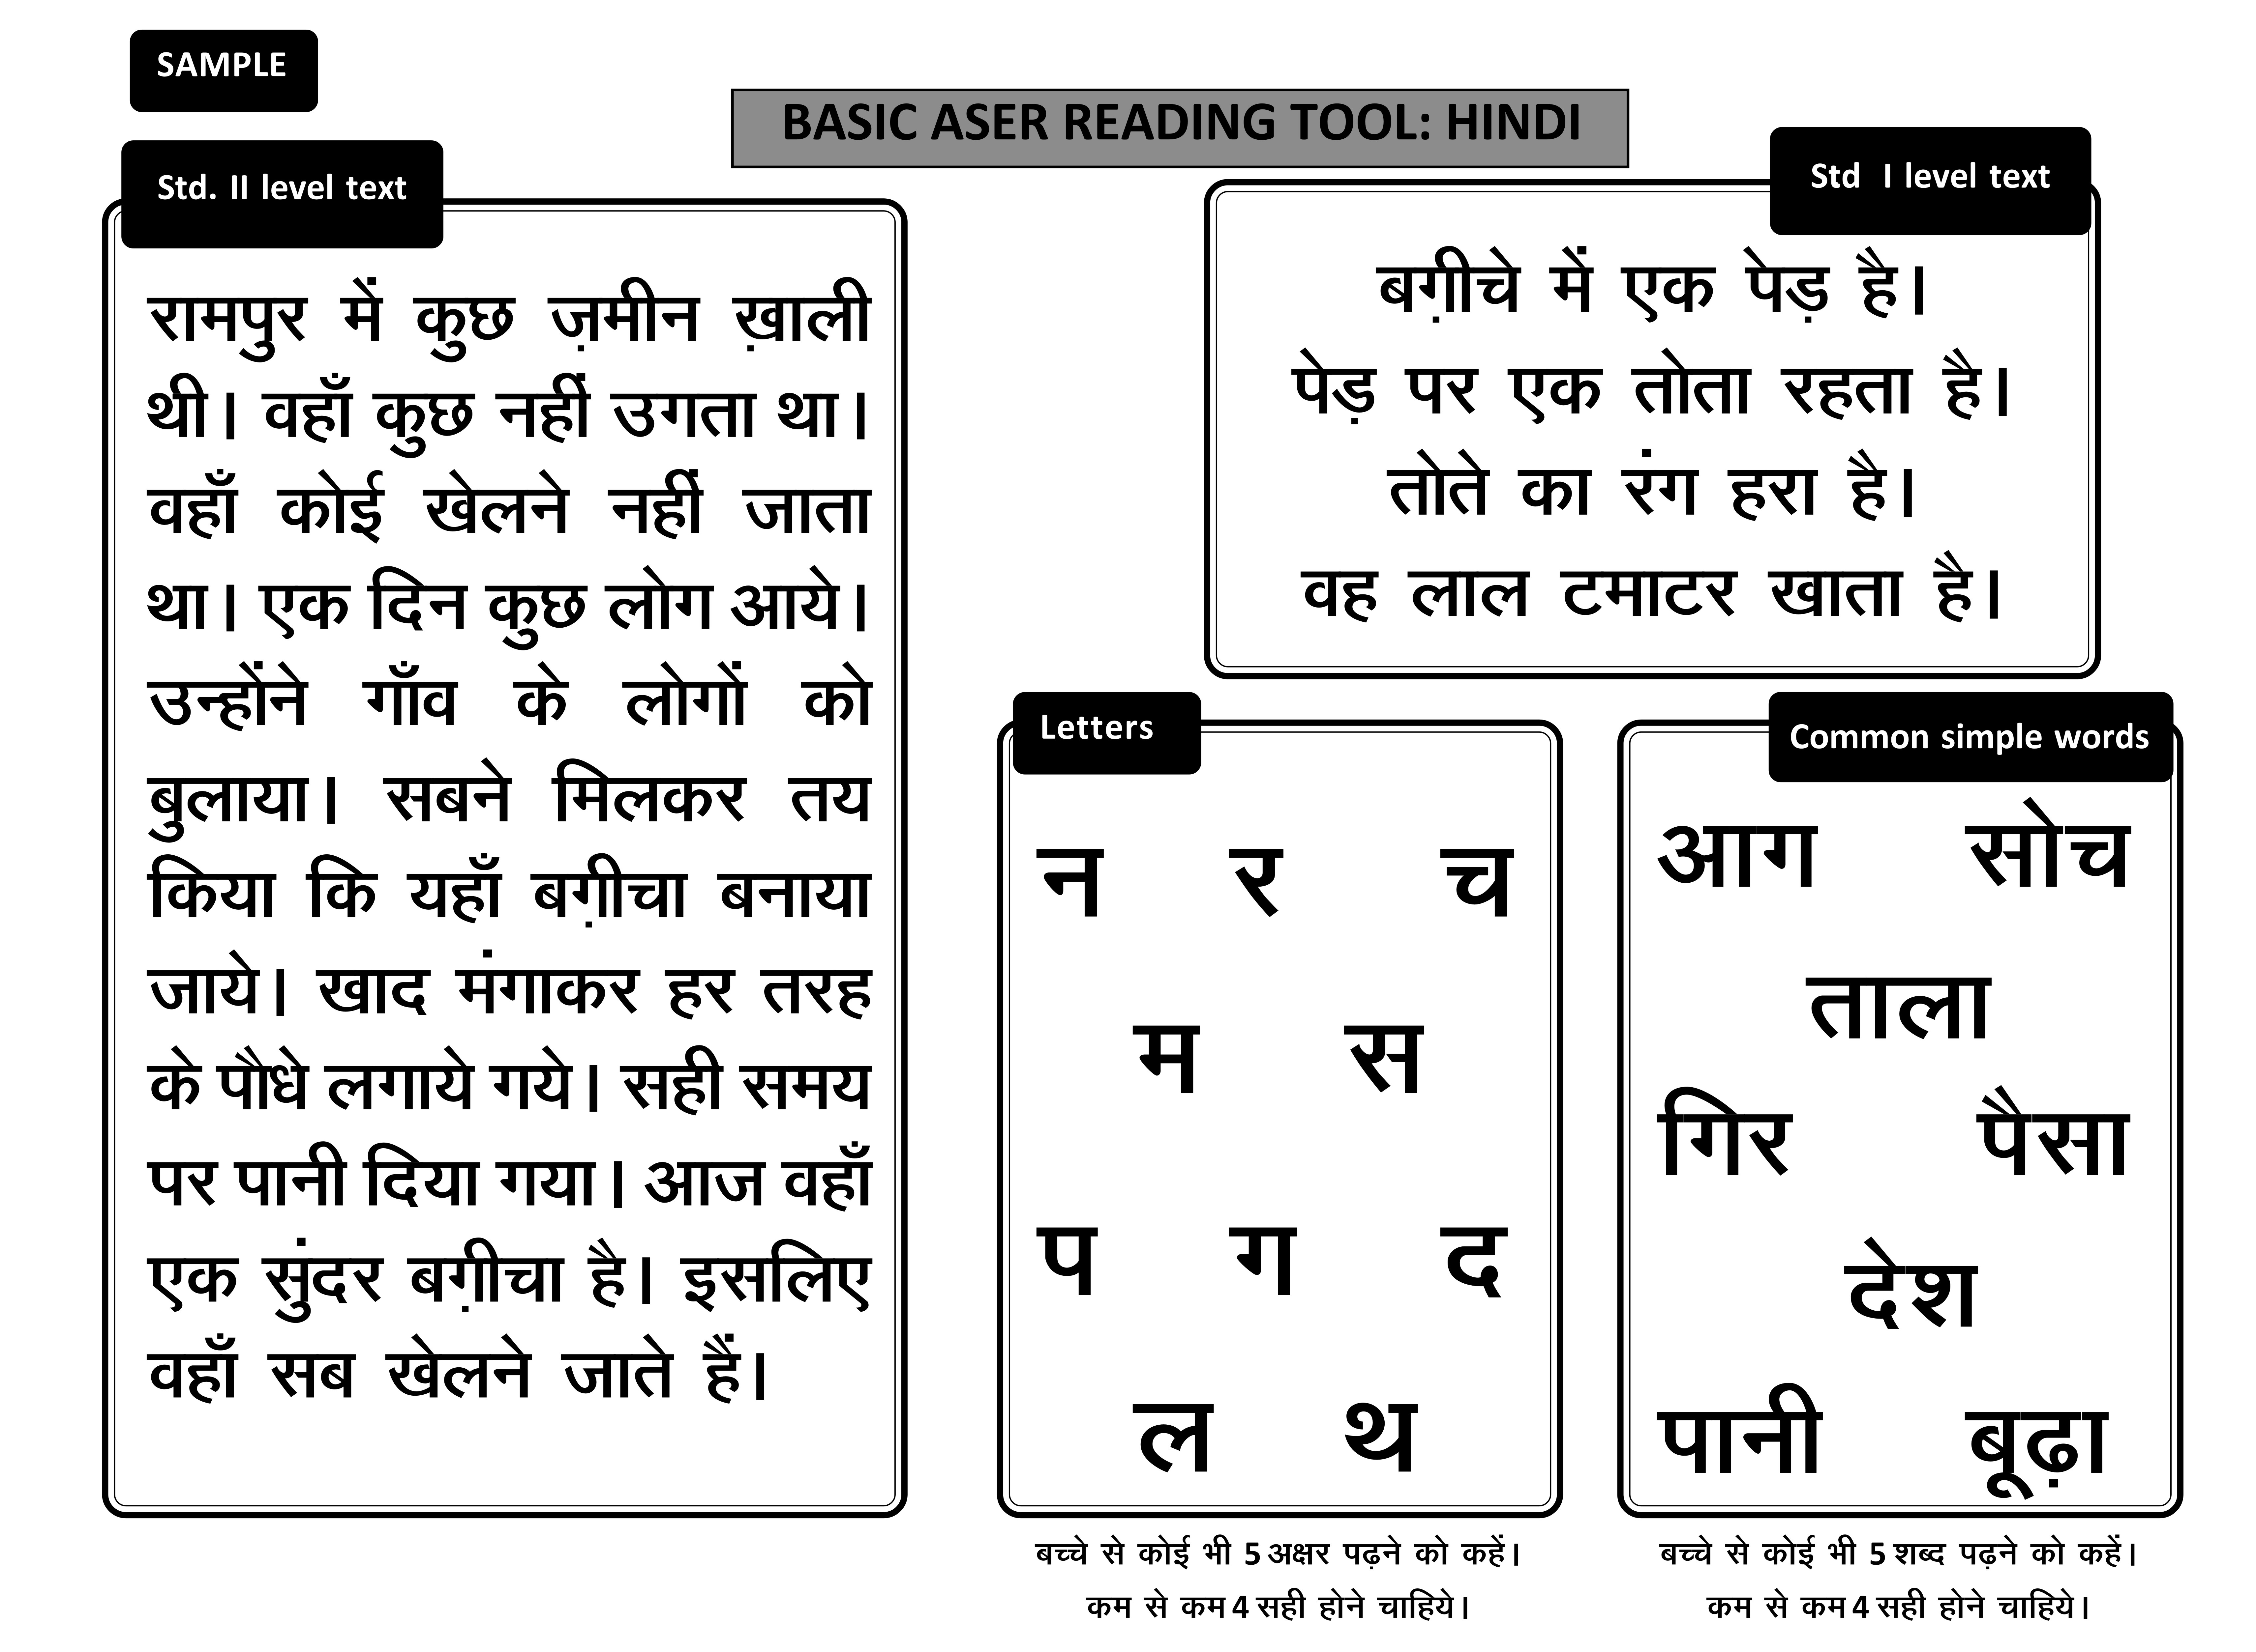
August 2012: Can children read?
Based on the reading assessment - “Mahal” /groups created based on reading level:
“Story” mahal
“Para” mahal
“Word” mahal
“Letter” mahal
“Beginner” mahal
Usually all children in Grade 3-5 put into three groups because there are typically three teachers in a school in this district.
August 2012
Total children tested = ~16,000 children
All students in Grade 3- 5
In 225 schools
Story = 16.4%
Para = 14.4%
Word = 12.1 %
Letter = 22.7%
Beginner = 34.4%
Total = 100%
GOAL : ALL CHILDREN READING AT “STORY” LEVEL BY END OF SCHOOL YEAR
Assessment tool and data feed directly into instructional practice

Slide 8
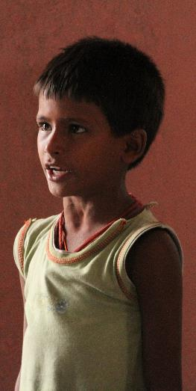
Sept 2012: Rolling out
How much time was available?
Planning started as soon as summer vacations were over in July
Till September for preparations: CRCC practice classes, orientations for Head-teachers, printing of materials, training of teachers.
October-November full of festivals
December-January: Cold wave so schools shut. Need for refresher training of teachers.
March: End of school year.
Less than 100 days available in the 2012-13 school year for this intervention (1.5 hours a day)
Who would train the teachers?
Each CRCC had 40-50 teachers to train.
CRCCs had learned to “teach” but were under-confident about training and leading others.
2 CRCCs together trained their teachers. Pratham provided support.
This way all teachers trained in a week - 4 days each batch of 40-50.

Slide 9
March 2013 : Can children read?
PADHO JEHANABAD : CHILDREN IN Std 3, 4 & 5
Kako & Modanganj blocks (224 schools)
READING LEVEL | % Children who can read at different levels
 | Base line (Aug_2012) |  | End line (Mar_2013)
Story | 16.4% | % "Readers" = 30.8 | 53.5% | % "Readers" = 72.3
 |  |  | 18.8%
Para | 14.4%
Word | 12.1% |  | 14%
Letter | 22.7% | % Who cannot read even words = 57.1 | 9.5% | % Who cannot even read words = 13.7
Beginner | 34.4% |  | 4.2%
Total % | 100 |  | 100
Children tested | 16540 |  | 15972
This assessment was done by school teachers for their own children. An sample based external assessment was also carried. out.

Slide 10
January 2013: State wide scale up?
Alternative theories of change & paths of action
Pre-occupied with inputs
Unless all inputs are in place, quality cannot improve.
(Right to Education Law stipulates norms)
Huge teacher shortage. Difficulties in teacher recruitment. Deal with these problems.
Tighten administration and monitoring
Teachers have never been made to teach in Bihar.
If teaching happens, then learning will take place.
Hence, focus should be on teacher attendance, tight monitoring and punitive action if teachers are not teaching.
Build institutional capacity
Teachers not capable of teaching.
Build and strengthen teacher training institutions. Long run investment and time needed.
Campaigns for learning improvement can energize the system even with existing resources and capabilities
Structural problems – “Negative consequences of overambitious curriculum” - children do not even have basics. So set basic goals. Teaching at the right level is the answer.

Slide 11
Background: What “works” to improve learning?
A decade of “delivering” models - Pratham
Children “left behind” are invisible. The assumption is schooling = learning is not correct. Clear focus on learning needed.
LEARNINGS
Mobilization of local community volunteers on scale is possible especially in rural areas. Youth volunteers enable children to learn well and also provide bridge between home and school .
BUT volunteer participation is seasonal and often does not sustain over time.
Foundational skills – basic reading, basic arithmetic need to be in place so that higher skills can be built. Teaching at grade level leaves the majority behind. Not much home support as parents are illiterate or have little schooling.
WHAT
Catalyzing school systems for learning improvement is possible. Past Pratham statewide partnerships with MP, CHH, HP, Punjab, UP.
BUT partnerships are not durable. Very dependent on individuals and their leadership.
HOW
Appropriate assessment can lead easily to appropriate action.
Children who are age 8+ can learn quickly. Accelerated learning is possible. Simple and low cost methods and materials are effective. Can be used by many.
ASER has helped to build awareness of problem at macro level.
BUT translating into action slower

Slide 12
Background: What “works” to improve learning ?
A decade of delivering evidence - JPAL-Pratham RCTs
Youth volunteers support for improving children’s learning
Mothers help to improve children’s learning
Teachers teaching at right level to improve children’s learning
Pull out classes in school during school hours by community volunteers for building basic skills for children in Grades 3-5. “Balsakhi” study in urban Mumbai and Vadodara. 2001.
Adult literacy classes for mothers as well as mother-child engagement activities to improve basic learning for children in Grade 1-3.
Rajasthan & Bihar – rural 2010.
Summer camp where govt school teachers grouped children by level not grade to reach basic reading and arithmetic goals. Summer camp far more effective than year long grade level teaching.
Bihar - rural: 2008 - 2010
Community based classes by local youth volunteers for building basic skills for children in Grades 3-5. “Jaunpur: study in rural eastern UP. 2005.
In-school special period during school hours. Children in Grade 3-5 taught by level not by grade. Govt. school teachers.
Haryana - rural : 2012-2013.

Slide 13
April 2013 : Bihar government announces state wide roll out of “teaching to the right level” as part of the Mission “Gunwatta”(Quality)
“Making dramatic change in learning is possible”: Learning goals stated by govt
100% of children in Grade 5 to be brought to Grade 2 level
75% of children in Grade 4 to be brought to Grade 2 level
50% of children in Grade 3 to be brought to Grade 2 level
Aim is substantial and significant improvement in learning numbers in ASER
BROAD COMPREHENSIVE STRATEGY
FOR BUILDING QUALITY & IMPROVING LEARNING
Rebuilding teacher development institutions
Improving service conditions of teachers
Basic report cards for students in class
Local language bridge material in early grades
75% attendance needed to get entitlements
Special efforts for the “very backward” groups
Scholarships for all girls Grade 1 to 10
Recognition for outstanding schools
Specially earmarked teachers for Grade 1-2
Teaching to the right level – remedial education for Grade 3-5 – 2 hours a day – regrouping by competency

Slide 14
Status of scale up right now …………
Pratham teams working in partnership with district teams in 12 districts where district has actively wanted the collaboration. Close view of scale up………
DELAYS IN SYSTEM FUNCTIONING
Delay in recruitment of CRCC
Delay in sanction of funds for teacher training
Delay in approvals for printing teaching-learning materials
Delays in printing and distribution
October-mid November many festivals
Actual scale up on the ground may begin in mid Nov. Chances are that only 80 instructional days left to end of school year
Note: Blue cell = activity done. White cell = activity not done yet

Slide 15
Other clouds for the “Big Picture” …………
POLITICS AND COMPULSIONS
Bihar coalition between JDU & BJP fallen apart
General elections in 2014
State legislative elections in 2015
Local village council elections in 2016
Is it electorally risky to announce outcome goals and then fail to deliver in full measure?
COMPETING POLICY PRIORITIES
12th Plan document: Focus on outcomes
Right to Education Law : Focus on inputs and provisions
Which policy directive to follow?
DETERIORATING ECONOMIC CONDITIONS
Decline in growth rates
High inflation
Can we afford new ideas? Risks?

Slide 16
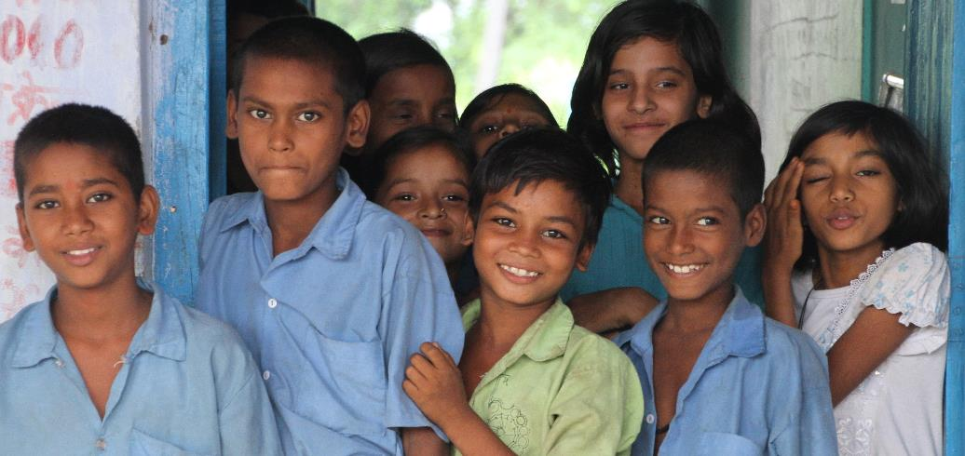
See the video from Jehanabad
http://www.youtube.com/watch?v=XB5Wih-Ng8Y&feature=youtu.be
For more info: rukmini.banerji@pratham.org
www.pratham.org and www.asercentre.org

