Slide 1



What’s In, What’s Out?
Designing and Adjusting Health Benefits Plans for Universal Health Coverage
6th-9th March 2017
Sheraton Pretoria, South Africa
Module 2:
Methods for the Development and Adjustment of HBP
Decision rules in an end-to-end HTA system: New Zealand
Tommy Wilkinson, BPharm, MSc
Senior Technical Advisor
PRICELESS SA, Wits School of Public Health, Johannesburg, South Africa
Email: tommy.d.wilkinson@gmail.com
Acknowledgement: Sarah Fitt, Director of Operations, PHARMAC

Slide 2
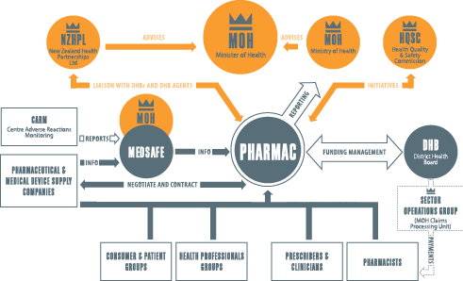
PHARMAC within the New Zealand health system
SOURCE: https://www.pharmac.govt.nz/about/your-guide-to-pharmac/factsheet-03-our-place-in-the-health-system/
Notes:
Source: https://www.pharmac.govt.nz/about/your-guide-to-pharmac/factsheet-03-our-place-in-the-health-system/

Slide 3
PHARMAC - a brief history
1993 - PHARMAC established, annual pharmaceutical spend $445M
1997 - First tender for sole supply in the community
2002 - Management of all cancer treatments
2003 - Annual spend $510M
    First decade - $2billion cumulative savings, 6% pa prescription growth
2012 - Management of immunisation vaccines
2013 - Annual spend $784M
    Second decade - $4billion cumulative savings, 6% pa prescription growth
2016 - $800 nominal budget, saved and re-invested $52.7 million, 44 million Rxs
Mission: “To secure for eligible people in need of pharmaceuticals, the best health outcomes that can reasonably be achieved, and from within the amount of funding provided.”
New Zealand Health and Disability Act 2000

Slide 4
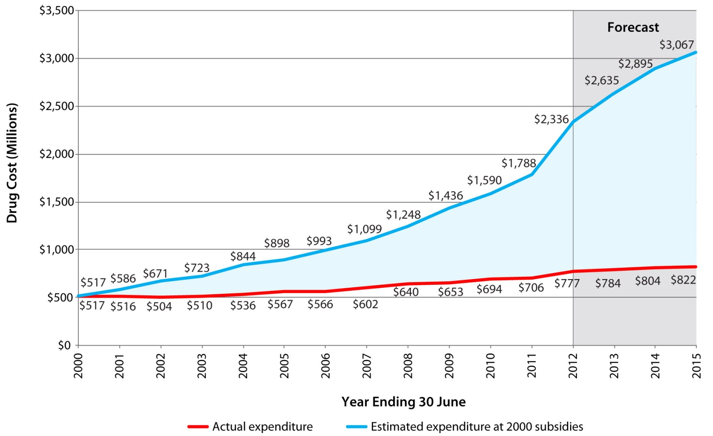
PHARMAC’s long-term impact
Notes:
Narrative: The red line illustrates actual spending while the top (blue) line shows what would have happened if the amount of medicines now funded had been funded at [year] 2000 prices. The difference between the lines is the cumulative saving as a result of PHARMAC’s activity, which by 2013 had reached $6 billion.

Slide 5
The HTA process
Defining
Decision Space
Analysis
Appraisal
Decision Making
Implementation

Slide 6

PHARMAC: The HTA process
Step 1: Receipt of Proposals
Step 2: Medical Advice – PTAC
Consider evidence
Step 3: Economic Assessment
Step 4: Prioritisation for funding
Step 5: Negotiation
Assess relative value
Step 6: Consultation
Step 7: Decision
Step 8: Implementation
Outcome
Notes:
Anyone can make a new drug funding application, but they tend to be made most often by pharma companies, as they are in the best position to provide us with all the information we need to properly assess the application.
The TGM then assesses the application and writes a cover paper, which is presented to PTAC along with the application in its entirety. The cover paper could include things like the TGM’s view of assumptions in the application around likely use, or a critical appraisal of the clinical studies. It could also include a preliminary budget analysis and brief discussion of cost effectiveness.
PTAC then reviews the application and makes recommendations to PHARMAC, which could include a recommendation to take the application to one of its specialist Subcommittees.
Assuming that PTAC’s recommendation was positive, we would then perform a budget analysis and the health economists would work on a cost-effectiveness analysis. This information helps us weigh up where the proposal sits relative to other funding applications with similar PTAC recommendations.

Slide 7
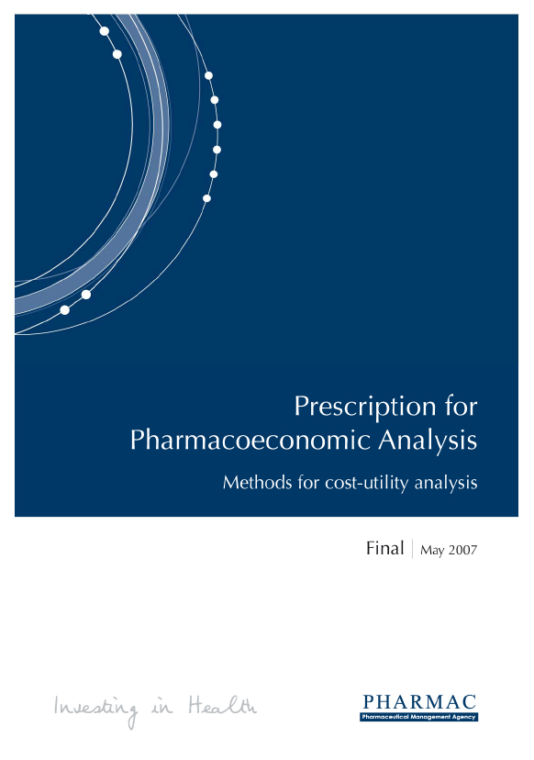
The Methods:
Prescription for
Pharmacoeconomic Analysis

Slide 8
The Methods: Prescription for Pharmacoeconomic Analysis
Type of analysis | Description | FTE Required
Detailed | A detailed and systematic identification and synthesis of relative clinical effectiveness, prognosis, health-related quality of life, and cost data. Evidence critically appraised. Costs and savings to other government organisations considered in the report in a qualitative manner. Probabilistic sensitivity analysis Appraised internally (clinical assumptions reviewed by the Pharmacology and Therapeutic Committee (PTAC)) and externally. | 2-6 months
Indicative | An interim assessment using some opportunistic data, but more detailed than a preliminary analysis. Evidence critically appraised. Reviewed internally (PHARMAC staff) and by PTAC. | 4-6 weeks
Preliminary | A rapid assessment largely using opportunistic data. Evidence critically appraised. Statistically non-significant events and costs only included if they are likely to change the results of analyses. Reviewed internally (PHARAMC staff). | 1-2 weeks
Rapid | A very rapid assessment using opportunistic data | 1-2 days

Slide 9
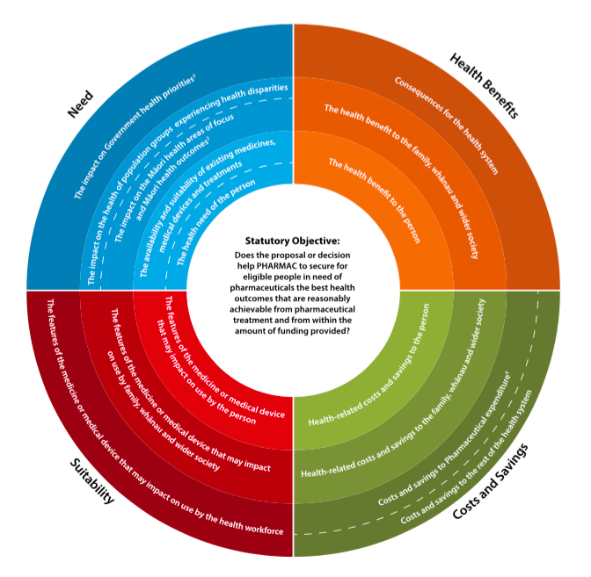
PHARMAC’s Factors for Consideration
Notes:
Needs 9 th criteria

Slide 10
The original nine (pre 2017):
Health needs of eligible people
Health needs of Maori and Pacific peoples
Availability and suitability of existing treatment
Clinical benefits and risks
Cost-effectiveness
Overall budgetary impact
Direct cost to health service users
Government priorities for health funding/Government objectives
Other criteria (with appropriate consultation)
Notes:
Needs 9 th criteria

Slide 11
Expenditure management strategies at PHARMAC
Negotiation and Bundling
Expenditure caps – can have up to a 100% rebate
Rebates – 2012 -17% of expenditure was rebated
Reference pricing
Tendering – generics 70% of volume and 30% of expenditure

Slide 12
Fluconazole 200 mg capsules
In 2005 we obtained a 93% price reduction. Competition has continued into the second tender when we achieved a further 55% off, now $13.34 a pack freeing up $1.9M for new investments
$628
$1.9
million
$41.50
$13.34
1993
2005
2009
Notes:
While on patent we paid about $630 a pack for fluconazole spending close to $2M a year in 2005.
In 2005 we obtained a 93% price reduction.
Competition has continued into the second tender when we achieved a further 55% off now $13.34 a pack
This year we expect to spend $100,000
So within 4 years = savings of $1.9M have been generated as a result of generics.
Generics are not just important to PHARMAC.
Other countries are also very interested.
Let’s look at what is happening elsewhere…

Slide 13
Hypothetical priority list
Proposals are not necessarily funded in the order they are prioritised.
Priority | Proposal | Indication | PTAC priority | CUA rank | QALYs per $1m, likely (possible) | Proposal expenditure (first year) | Cumulative expenditure
1 | Fantasticol | Lupus | High | 1 | 40-80 (20-100) | $80,000 | $0.1m
2 | Colomab | Colorectal cancer | Medium | 2 | 25-50 (15-50) | $5,000,000 | $3.8m
3 | Rheumatol | Rheumatic fever | High | 6 | 5-10 (3-10) | $800,000 | $4.4m
4 | Typhoid vaccine | Typhoid prevention | High | 5 | 5-12 (2-20) | $330,000 | $4.7m
5 | Metoogrel | ACS | Medium | 3 | 7-13 (4-16) | $220,000 | $5.6m
6 | Tagagliptin | Diabetes | Low | 7 | 4-8 (0-10) | $500,000 | $6.1m
Notes:
This highlights our ‘relative’ assessment of treatments and how the budget is applied. I think this is a key slide for the iHEA audience
Fictitious set of drugs.
Colomab overcomes PTAC ranking on high CUA result.
Rheumatol pushed up because of its high Māori health need.
Typhoid vaccine moved up by government priorities.
Metoogrel pushed down by low health need given large number of other options.
Tagagliptin not moved up despite Māori health need and government priorities due to poor CUA result and PTAC recommendation.

Slide 14
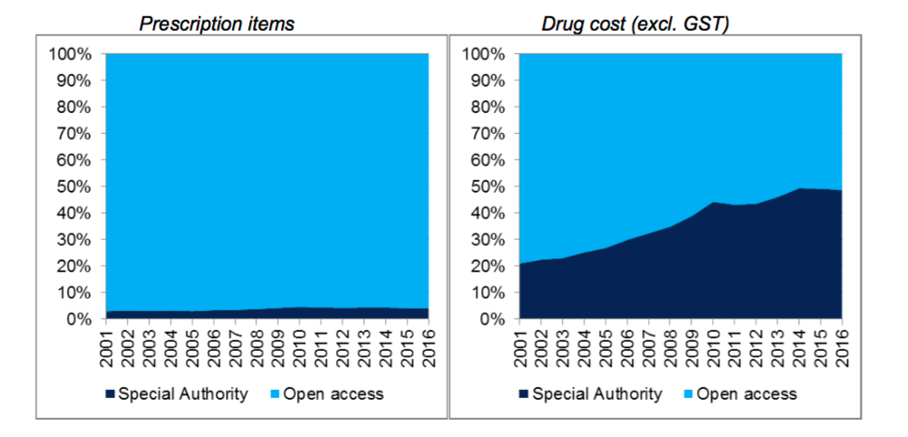
Linking implementation strategies: Special Authority

Slide 15
PHARMAC’s Unique situation
Budget
Set by Minister and District Health Boards
Relative Negotiations
Assessment Competition for
No cost-effectiveness available funding
threshold
Allows Programme Budgeting and Marginal Analysis

Slide 16
Budget Impact as decision criterion
Relatively easy to comprehend and calculate
Pragmatic approach – can we afford it?
Encourages discussion on price (but how low to too low?)
Discriminates against conditions affecting large populations
Unable to inform efficiency
Used exclusively, likely to cost lives through unrealized health gain

Slide 17
ICER as decision criterion
Allows consideration of technical and allocative efficiency – “value”
Potential to correct market failure
Requires consistent methods
Requires technical capacity to conduct and use
Used exclusively: places substantive pressure on methodology and appropriate threshold

Slide 18




Siyabonga - Enkosi - Thanks
www.pricelesssa.ac.za
Notes:
website

