Slide 1
Good governance principles for a sustainable HBP policy
HBP workshop South Africa, March 2017
Ursula Giedion
Consultant,
Director IDB LAC network on benefits packages and priority setting CRITERIA

Slide 2
What will we be talking about?
Ingredients of a sustainable HBP policy
Good governance as an ingredient for sustainability of HBP policies
Bad governance of HBP. Welcome to the real world
Key good governance principles in the context of a HBP policy
Cost&Risk of good governance

Slide 3
5 ingredients for a sustainable HBP policy
 | Ingredient | What is means for your HBP policy (Good governance principles embedded in these requirements for sustainability)
1 | The process of setting up and adjusting the HBP is practical. | -Do what’s feasible in your context, coherent with your time, money, political restrictions, info., skills.
2 | Secure broad support from providers, politicians, citizens and other stakeholders (they mobilize $ & give vital backing to difficult decisions) | -Stakeholders will want to have a voice. -Stakeholders will want to know what/why/how you are doing things. -Stakeholders need to trust in what you are doing. -Trust builds up over time, don‘t change your processes all the time, constistent & technically robust work.
3 | Your HBP must be affordable & implementable. | 3. Be coherent with your resources and other public policies.
  1..
  2.
  3. The HBP offered can be afforded with available resources.
Notes:
We want our HBP policy to be sustainable in time.
What are the necessary ingredients for sustainability? Most requirements are directly related with good governance principles Good governance principles embedded in these requirements for sustainability.

Slide 4
 | Ingredient | What is means for your HBP policy
4 | The HBP gets adjusted overtime given that a sustainable HBP is a living, evolving policy instrument that should adapt as new needs, evidence and capabilities emerge | -Think about who, how, when to adjust your HBP. Make it explicit and transparent. -Forget about a one time effort exercises.
5 | Your HBP is in line with goals and serves its purpose of setting limits. | -Make sure goals are a key element when deciding on what to prioritize now and in the future. -Resist political pressure to include services for political reasons. -Make sure resources get allocated to the benefits included in your package.
  1..
  2.
  3. The HBP offered can be afforded with available resources.
And all this in a very difficult policy context:
people care more about the health benefits they receive than most other public & health issues (eyes will be upon you!)
that „rarely increases the political capital of their architects“ & „is a higly inflammatory area“(Williams I. In Strengthening Health System Governance, Greer, Wismas and Figueras ed., 2016. European Observatory,
=SUSTAINABILITY OF YOUR HBP POLICY=DIFFICULT GOAL IN A VERY DIFFICULT CONTEXT
Notes:
We want our HBP policy to be sustainable in time.
What are the necessary ingredients for sustainability? Most are directly related with good governance. Good governance principles embedded in these requirements for sustainability.

Slide 5
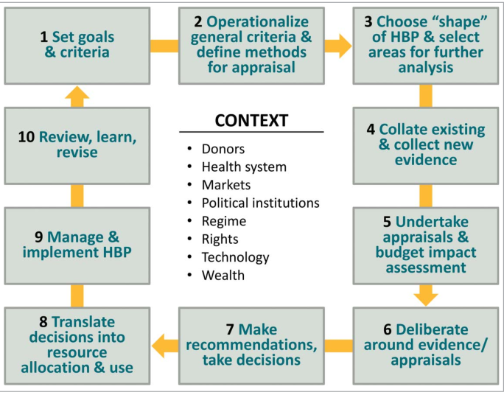

Maintaining a sustainble HBP policy-many process and much more than technical work
Many processes, many actors, never ending cycle.
Notes:
*/Source:
http://www.getty.edu/museum/media/images/web/enlarge/00208501.jpg The construction of the tower of Babel. The Construction of the Tower of Babel, about 1400 - 1410

Slide 6
Maintaining a sustainble HBP policy-many process and much more than technical work
  Someone has to act as the director of orchestra (and willing to pay the political cost)
  Processes need to made explicit and anchored in the normative framework.
  Responsibilitites must be distributed among existing institutions or new institutions must sometimes be created.
  Whatever the precise institutional design, proceses & package should be governed by good governance principles to be sustainable.

Slide 7
What is governance?
What we find, more often than not, in the real world of HBP policies
The systematic, patterned way in which decisions are made and implemented (Greer & Mckee, 2014). ➔The “way” decisions are made and processes are carried out normally.
Good governance relates to desirable process-related attributes of adequate benefit package design, adjustment and implementation practices. Good governance works in the absence of specially good leaders and is a defense against especially bad leaders (Greer & Mckee, 2014).
Bad governance: the „business of HBP design, adjustment and implementation“is normally done:
  W/o transparency, no timely and relevant info. Limited accountability mechanisms.
  No real participation of key stakeholders/behind closed doors,
  Erratically, unconsistently and without coherence with regards to time/processes/resouces/policies

Slide 8

Why is good governance important?
Symptoms of bad governance
A deficient governance may create symptoms such as:
  Process. Limited credibility, lack of trust, legal problems, indefensible decisions, erratic policy changes, stagnation of adjustment processes
  Results. Failed implementation inclusion of non-prioritized services or w/o clear benefit, outdated HBPs, unsustainable HBPs, no effective coverage of prioritized services
  And it may even lead to the collapse of the HBP policy all together:
Source: John Sell Cotman - Ruined House - Google Art Project.jpg

Slide 9
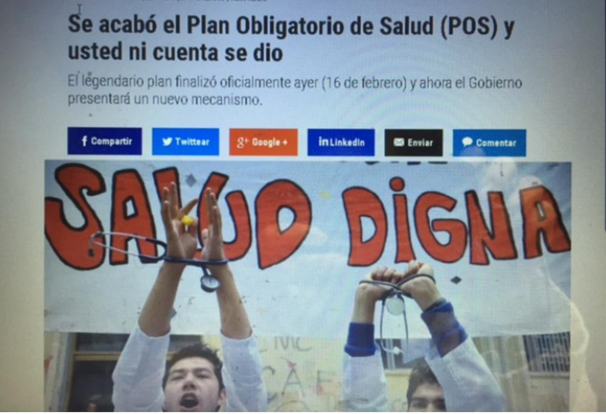
Why is good governance important?
Symptoms of bad governance
*/
*/
„It‘s over. The explicit health benefits package POS has ceased to exist yesterday“
**/
**/decent health
Source: El Pulzo. 17.2.2017. http://bit.ly/2lVSZDs

Slide 10
What are the key good governance principles?
Stakeholder participation
Transparency
Consistency, coherence

Slide 11

Transparency defined
Refers to the ability to look clearly through “the windows of an institution” or “lift the veil of secrecy”(Grimmelikhuijsen 2010).
Why does it matter?
  Enables participation and thereby legitimacy, accountability.
Source: Andrew Wyeth, Looking out, looking in.

Slide 12
Transparency dimensions
Transparency about
  Processes (whole policy cycle)-who, what, how
  Content of HBP-do people really know/understand the benefits?
  Results of HBP-goals reached? Effective coverage?
Not just “report sharing”-questions you might ask to find out whether a transparent HBP policy is being carried out:

Slide 13
Attributes of transparency | Country examples- Good practice | Country examples-Lack of good practice
Availability | -Routine information on access to AUGE health services by Superintendence | -No documentation on how the HBP of Colombia was originally designed -Most LAC countries limited info on effective coverage of BP content -LAC limited info on coverage decisions and processes
Standardization | -Chile AUGE benefits package. Common ground of benefits -Benefits package adjustment processes ad hoc and erratic in many countries. | -Russia, many different health benefits packages, no way to compare, Chile thousands of health packages of Isapres and no way to choose wisely. RepDom reports of HBP services use non standardized coding systems.
Timely and up to date info | -Colombia-institutionalized analysis of claims data with explicit schedules. | -Colombia-benefits advisory committee meant to review adjustment proposals but they do not arrive on time
Understandable, sufficient, relevant | Canada, Ontario, coverage decision information. | -Colombia, complex HTA reports
Bottomline message: transparency & ensuing scrutiny, empowerment, accountability depend not only on the quantity but also quality of the information

Slide 14
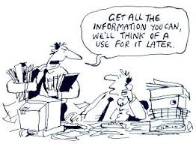
Transparency only if it has a real impact on your policy
Sunlight, as the saying goes, is the best disinfectant. And it’s tempting to think that if we just shine a light on wrongdoing, wrongdoing will go away…
Transparency is useful as long as it is accompanied by enabling factors such as accountability mechanisms, participation.
In this case..don‘t even bother to implement transparent HBP policies

Slide 15
Participation of stakeholders why?
“Principle 10: HTA programs should actively engage all key stakeholders in all stages of the process, as this is likely to result in technology assessments of higher quality that are more widely accepted and stand a greater chance of being implemented. Moreover, such an open process will enhance transparency & trust in the process as stakeholders develop a greater understanding of the criteria and standards”.
    Drummond et al., 2008. Key principles for the improved conduct of HTA for resource allocation decisions
4 reasons of why participation is important for a sustainable HBP policy:
Legitimacy
Quality of decision
Accountability
Ownership

Slide 16
Participation and quality of decisions. Examples.
Country/ source | Pre-participation | Value added by participation
Chile/AUGE | Dentures were initially not considered for inclusion in HBP | Focus groups with vulnerable groups of women evidenced huge impact of dentures for quality of life.
U.K./NICE documented by Littlejohns et al. 2009 | Clinical research indicated that quality of life of patients with psoriasis depended on the SIZE of injury | Patients showed that location of injuries were even more important than size.
U.K/NICE | Typical and atypical antisychotics were considered equivally effective from a clinical perspective | Mental health patients showed that side effects were completely different.

Slide 17
Design of participation in HBP design. Key questions.
What type of participation (from very soft to very commiting)?
Empower of decisions
Involve in process &seek collaboration
Create multistakeholder decision bodies
e.g. Citizens in deciding on the criteria used to choose interventions
Consult
Little evidence on what works best
Real life participation mostly very lmited
Context specific
e.g. Ask stakeholders @ their views on inclusions, criteria.
Inform
e.g. Actively inform health care providers and patients about benefits and methodologies

Slide 18
Participation. Some key concerns...
Conflicts of interest.➔Manage explicitly
Imbalance of power/skills to participate (for example patient advocacy groups versus lay citizens and defendants of cinderalla issues)
Do not just use for pro-forma validation.
Try to institutionlize participatory processes
  Explicit rules of how, when with whom
Is resource intensive. Ergo? Use appropriately and only if you are willing to take into account what stakeholders have to say.
  Examples: Chile/AUGE and Colombia/negative list (relevant to ask lay persons what they want to EXCLUDE from a HBP?).

Slide 19
Consistency and coherence.
Examples from the real world
 | Examples
Consistently applied criteria & processes to update the HBP | Dominican Republic. Ad hoc adjustments with no clear nor explicit criteria. Colombia. 5 different institutional designs in 10 years to adjust the HBP Chile. Normative framework establishing criteria, studies etc. To adjust the HBP.
Coherence HBP content+ HBP goals | Inclusion of services into HBP despite limited effectiveness or w/o logical sequencing. Many countries.
Coherence with resources (time, $$ infrastructure, information) | Update a HBP in 3 months. Honduras. Review the whole benefits package in 6 months (Colombia). Ambition to design a fully HTA based HBP (many countries)
Coherence w. other policies | Different and unarticulated institutional frameworks to update ELM and HBP (Peru, RepDom, Mexico, etc.)

Slide 20

On consistency and articulation policy wise
The HBP does not exist in isolation. If it is to be more than a de jure wish list of services, HBP must inform health system functions such as payment, provision, financing.
Payment, provision, financing
HBP

Slide 21
Consistency & coherence for HBP policies
Does it matter?
  Commitments, trust.
  Reduces influence of interest groups.
  Efficiency in processes.
  Learning process/virtuous cycle.
  Better results.
  Allows measurement.

Slide 22
Risks & costs of good governance
Resource intensive. Needs money, time, personnel.
Can backfire: can produce unexpected/undesired and even opposite results.
  Partcipation can become counterproductive when only those with strong voice participate and make themselves hear...
  Too much transparency can create a blaming culture and disincentive moving forward..policing…
Can be converted into a formality, a non-consequential, proforma exercise.
Not necesarily smoother decision making process but well done more sustainable HBP policies.

Slide 23
Risks & costs of good governance
Consistency, participation, etc. are all words with very positive connotations, but they also involve risks and costs:
  speed, efficiency, effectiveness, flexibility, creativity, empowerment and innovation may be obstructed by good governance.
  It is costly.
  It can backfire when used to block processes.
If you go that road, be sure you are prepared to take it seriously (and bare the consequences of critique, negotiation, second best solutions).
Not necesarily smoother decision making process but well done more sustainable HBP policies.

Slide 24
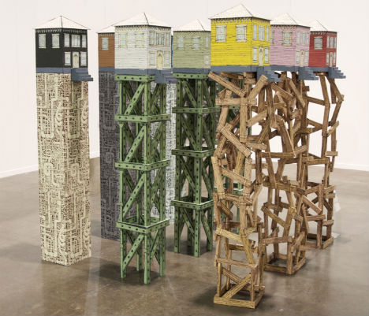
HBP
THANKS
Good governance principles make HBP sustainable but Do not implement as an end in itself but rather as a means to an end… A SUSTAINABLE HBP POLICY!
Source: Artist Luke O’Sullivan. „flood-proof housing“

Slide 25

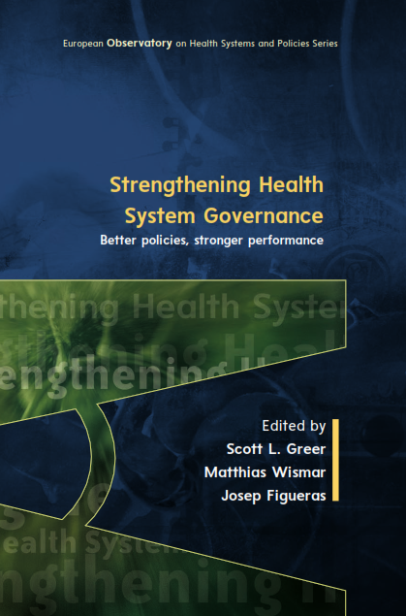

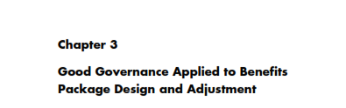
Some readings

