Slide 1
Health benefits packages for UHC: wrench in the works or keys to control?
Presentation for the
Workshop on Design and Adjustment of HBP
Amanda Glassman
Center for Global Development
March 6, 2017

Slide 2
Structure of presentation
Why health benefits plans (HBP) for UHC
Defining HBP
How could HBP help with UHC goals and functions
HPB policy cycle
  Tour through a few steps
Some common pitfalls
Main messages

Slide 3
Why HBP for uhc?
1

Slide 4
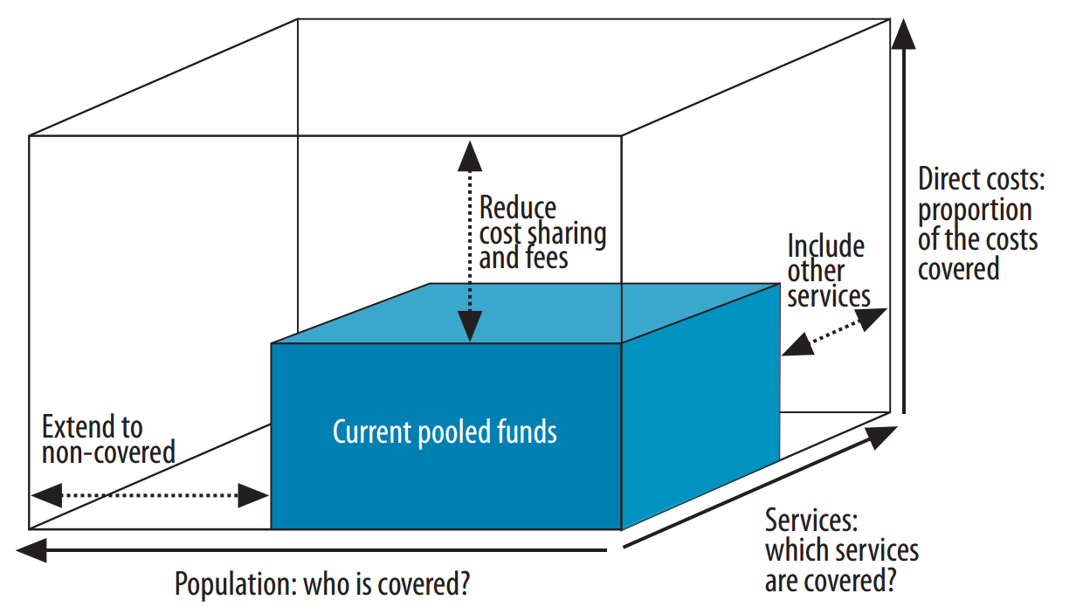
Balancing coverage with available financing is the UHC imperative
Direct costs:
What proportion of the costs are covered?
Services:
Which services are covered?
Population:
Everyone is covered?
Notes:
PDF of figure: http://www.who.int/whr/2010/10_chap1_fig02_en.pdf

Slide 5




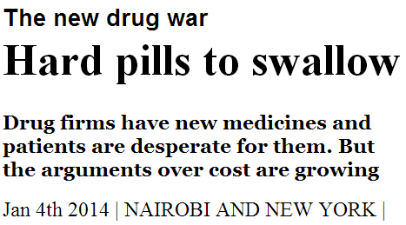
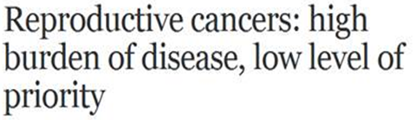
Competing priorities and interests at many levels in ad hoc or inertial process of resource allocation = implicit rationing
Many ‘priorities’…
…many interests
MSF asks India to make affordable hepatitis C medicines as Natco resists expensive US drug patent
12-04-2014
By Sehat
Bookmark
Notes:
http://www.pharmabiz.com/NewsDetails.aspx?aid=79871&sid=1
http://www.economist.com/news/international/21592655-drug-firms-have-new-medicines-and-patients-are-desperate-them-arguments-over?frsc=dg%7Ca
http://www.thehindu.com/todays-paper/tp-national/tp-kerala/guidelines-bring-pph-deaths-under-control/article5239072.ece

Slide 6
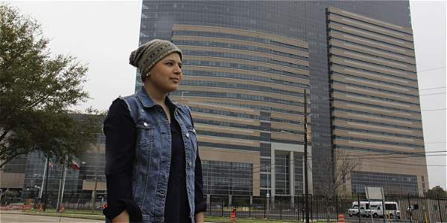
It gets personal quickly
Colombia: Camila Abuabara
Sues for public coverage of a liver transplant in US hospital
Twitter:
  Ministro de salud @agaviriau me condena a la pena de muerte en Colombia y según él yo debo de aceptar gustosa junto a su compinche de EPS

Slide 7

And ad hoc practices lead to inequities…
Hospital committees that decide who gets a spot under limited dialysis budget:
  In South Africa, between 1988 and 2003, white patients were nearly four times more likely to be accepted for dialysis treatment than nonwhites (NPR 2010, Sheri Fink)
Patients sue for public coverage, opportunity costs not considered by legal system
  Rafael Favero, a patient with a rare anemia, sue for a $440,000 drug and wins in Brazil (http://revistaepoca.globo.com/tempo/noticia/2012/03/o-paciente-de-r-800-mil.html)
Fixed budgets for seeking healthcare overseas:
  Guyana sets aside an amount and its use is first-come, first-served, no criteria. Exceptions go to president for decision.

Slide 8
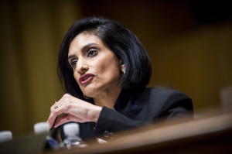
And ad hoc practices lead to inequities…
News | Science | Health | Nation
GOP Seeks Reduction In Affordable Care Act's 10 Essential Benefits
by Michelle Andrews NPR | Feb. 22, 2017 7:04 a.m.

Slide 9
Defining hbp
2

Slide 10
Defining health benefits plan
Minimum attributes:
  Total size is constrained by available funds
  Completely or partially constrains products and services available through health system
  Comprises a portfolio of products and interventions
    Not a single technology, not a vs. b
Not:
  Ad hoc rationing or implicit resource allocation (using budget until $ runs out then user fees or no provision, or constraining supply capacity)
A technical but also political, procedural, institutional, fiscal, ethical and legal undertaking
  Informing all relevant health system functions in order to be effective

Slide 11

Content, scope and depth of benefits: key to connect between control knobs and outcomes (or the wrench in the works)

Slide 12
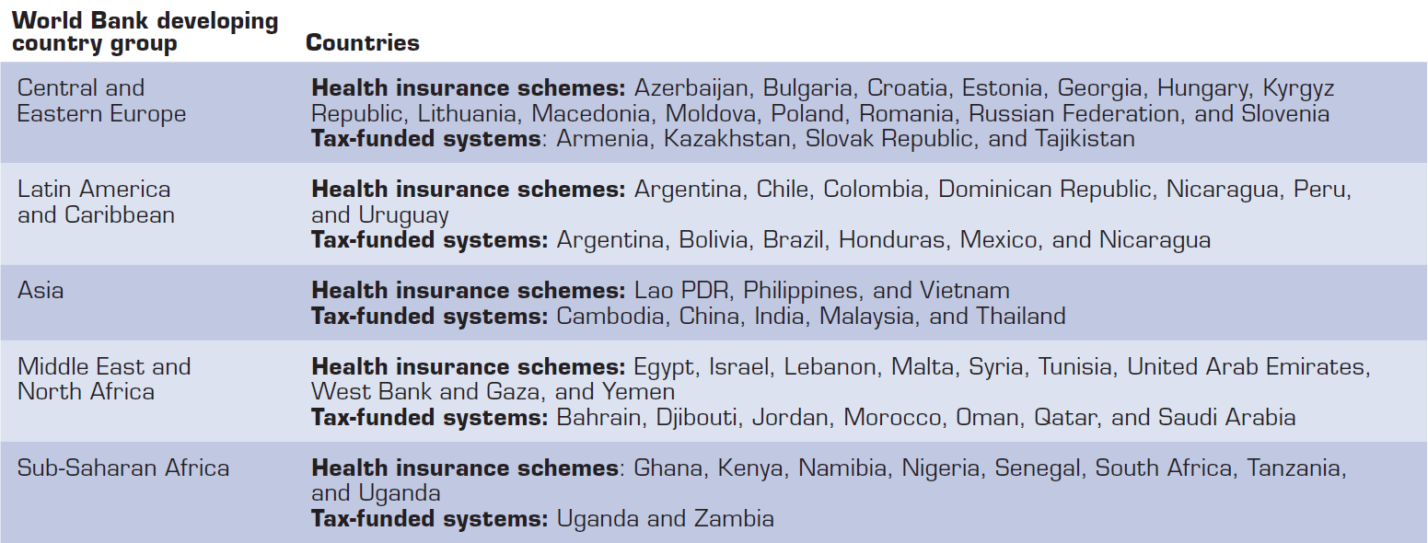

Many LMIC establish HBP in both health insurance schemes and tax-funded systems
Low- and Middle-Income Countries with Health Benefit Plans
*check UNICO update to list

Slide 13
How hbp are used to improve uhc outcomes
3

Slide 14
How can health benefits plans help achieve UHC outcomes and functions?
Maximizes health, enhances value for money
  Introduces greater evidence into public spending decisions
  Incentivizes the development of cost-effective new technologies
  Informs pricing negotiations
Informs provider commissioning or payment
Informs budget expansions or as input to sizing of fiscal transfers
Cuts costs, reduces waste and harm
Provides the means to regulate private health insurance
Enhances equity and reduces care variations
Improves accountability between payers, providers and patients
Notes:
HBP not only or best solution… but is one currently in use as an alternative or antidote to implicit and ad hoc priority-setting
Maximize health, enhance value for money
WDR93, CMH2001, GH2035
Thai HTA for UC package
Purchase care from providers
Most payer-provider splits, RBF systems
Budget expansions or as input to fiscal transfer systems’ capitations
Canada, Mexico
Cut costs:
Troika in Portugal and Cyprus
Reduce waste:
Negative lists or do-not-do
Enhance equity and reduce care variations
Improve provider accountability to patients and payers
Introduce greater evidence into public spending decisions
Incentivize the development of cost-effective new technologies

Slide 15
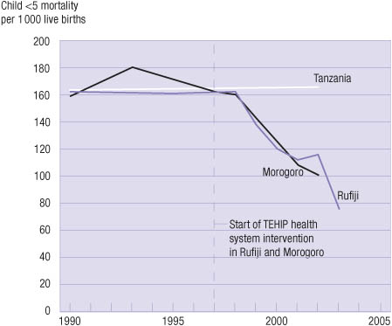
Maximizes health: remember the Tanzania Essential Health Interventions Project (1997-2002)?
Prospective follow-up study in two districts with 741,000 population (DSS + verbal autopsy)
Essential health benefits package defined based on district-level cost-effectiveness data
District Health Management Teams (DHMT) allocated budget based on per capita cost of package and population size
DHMT can deploy resources flexibly
Accompanied by training, tools, support

Slide 16
Maximizes health:
Chile’s AUGE increases production and utilization of high-value services
Identification of 56 (now 80) prioritized health problems (based on multiple criteria)
75% burden of disease
Associated clinical guidelines based partially on cost-effectiveness (446)
Associated interventions (8005)
Guarantees of access, financial protection, timeliness of care
Rest is still provided but without guarantees

Slide 17
Maximizes health:
Chile’s AUGE increases production and utilization of high-value services
Health problem | Hospitalization rate 2000-2006 | Case-fatality rate 2000-2006
Hypertension | 10% drop | 11% drop
Type 1 diabetes | 7% drop, especially among patients older than 30 years; steepest drop seen among ISAPRE beneficiaries | 48% drop
Type 2 diabetes | 13% increase, especially among older adults (older than age 65); steeper increase (72%) among ISAPRE beneficiaries, possibly because of better access to care or—to some extent—to population aging | Hospital death rate dropped 5%—a noteworthy finding given that this is an older, higher-risk population
Epilepsy | 8.9% combined increase for all age groups; 11.4% observed increase among patients younger than age 15 (target population of AUGE); eightfold increase among ISAPRE beneficiaries | 98% drop in fatality in all cases; no data are available to distinguish that rate between the population of AUGE beneficiaries for this disease (younger than age 15)
Depression | 26% increase for the entire population, 45% increase among adolescents; fivefold increase among ISAPRE beneficiaries | 98.6% drop
HIV/AIDS | 24% global drop, a large part of which comes from children and adolescents who are beneficiaries of FONASA | 56% drop

Slide 18
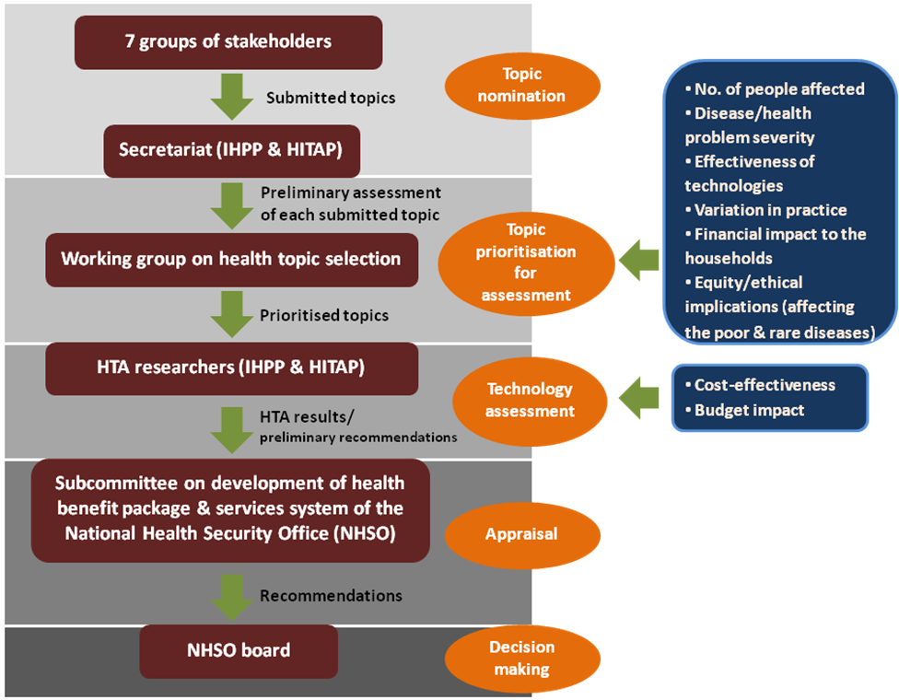
Enhances value for money:
Thailand’s HTA-informed universal coverage package

Slide 19
Enhances value for money:
Thailand’s HTA-informed universal coverage package
Drugs under consideration | ICER (Baht/QALY) | Coverage decisions | Year
pegylate interferon alpha 2b plus ribavirin for treatment of chronic hepatitis C sybtype 1 4 5 & 6 | cost-saving | Yes | 2011
pegylate interferon alpha 2a plus ribavirin for treatment of chronic hepatitis C sybtype 1 4 5 & 6 | cost-saving | Yes | 2011
lamivudine or tenofovir for treatment of chronic hepatitis B | cost-saving | Yes | 2011
simvastatin for primary prevention of cardiovascular disease | 82,000 | Yes | 2009
Galantamine for treatment of mild-to-moderate Alzheimer's disease | 157,000 | No | 2010
donepezil, rivastigmine for treatment of mild-to-moderate Alzheimer's disease | 180,000-240,000 | No | 2010
osteoporosis drugs (alendronate, residronate, raloxifene) for primary and secondary prevention of osteoporotic fractures | 300,000-800,000 | No | 2009
atorvastatin, fluvastatin. pravastatin for primary prevention of cardiovascular disease | negative dominant | No | 2009
recombinant human erythropoietin (rHuEPO) treatment in chemotherapy-induced anemia | negative dominant | No | 2008
adefovir, entecavir, telbivudine, pegylate interferon alpha 2a for treatment of chronic hepatitis B | negative dominant | No | 2011

Slide 20
Enhances value for money:
Thailand’s UC decisions have more than paid off economic evaluation costs
Annual cost of HITAP: 37 mn Thai baht (0.007% of THE in 2010)
Description
Impact
Health gains: 1500 averted new cases and 750 female deaths per year
Cost savings: 6 million international dollars, approximating 0.02% of the total health expenditure budget in 2007
Assessed possibility of universal coverage of the HPV vaccine using cost-effectiveness analysis
Compared multiple scenarios to conclude that the most cost-effective strategy would be improving screening accessibility rather than universal vaccination
Cost savings from the cervical cancer screening assessment alone more than covered HITAP’s operating costs (0.01% of THE budget in 2007)
Prevention of cervical cancer (2007)
Assessed value-for-money of three-ARV regimen vs. current AZT monotherapy and single dose of nevirapine
Solved social debate regarding feasibility and value for money of a new drug regimen in PMCT of HIV
Health gains: 101 paediatric HIV infections averted annually
Cost savings: 2.6 million USD over a lifetime
New drug regimen in PMTCT of HIV (2010)
Source: First Step Program Evaluation Report 2010; Praditsitthikorn N et al. 2011; HITAP Case Study 12March2011 (unpublished);
PMTCT in Asia Manuscript 2011 (Unpublished)

Slide 21
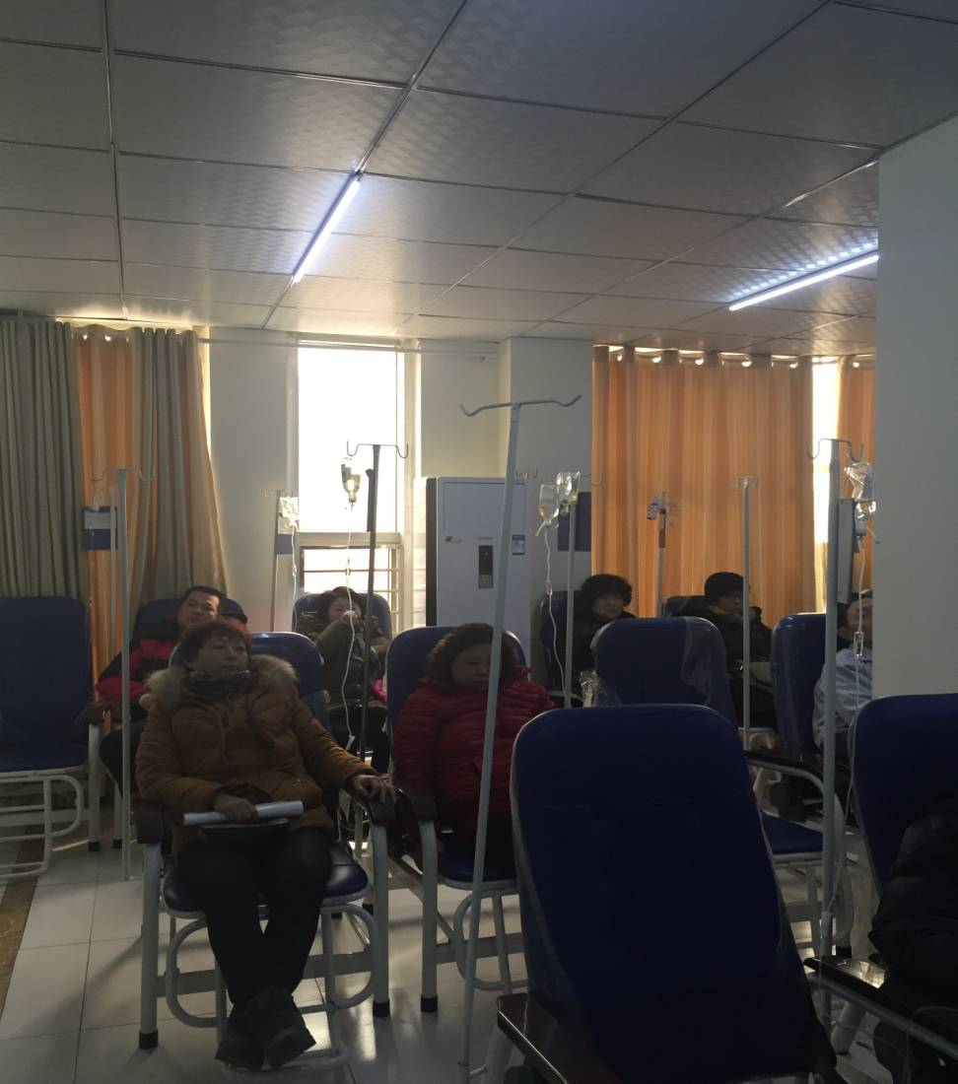
Informs provider commissioning or payment:
China’s provider payment method reform
Over use:
  Source from 6000 prescription survey
    Antibiotics 42%
    Hormones 15%
    Vitamins 69%
  NDRC deputy director address in 18th NPCSC
    IV injection 10.4 billion bottles in total 2010, 8 bottles/person, far above the 2.5 to 3.3 bottles international level

Slide 22
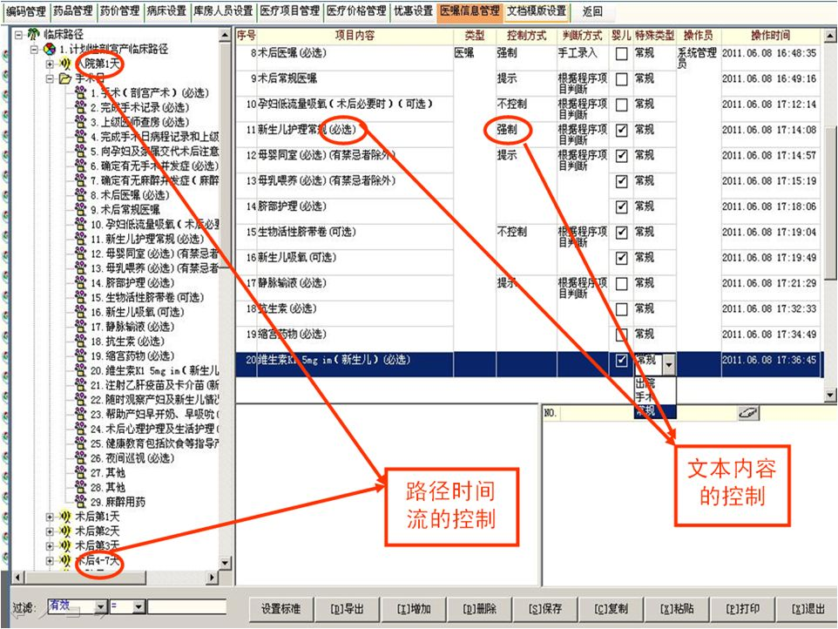
Informs provider commissioning or payment:
China’s provider payment method reform (FFS → DRG)
Priority: 100% covered by NCMS.
Min cost
可选
Selected: 30-40% covered by NCMS.
Potential cost
Necessary
LOS
Ceiling reimbursement price established
If savings: shared by hospital and doctors
Optional
可选项
OOP costs capped @ lower levels

Slide 23
Informs budget expansions and sizing of fiscal transfers:
Mexico’s Seguro Popular package
Per capita packages in Mexico
SSA vs IMSS
Example Mexico/Seguro Popular:
  «..[]The benefits package was meant to help correct this inequity by guaranteeing the allocation of a specific amount of money per person. By establishing the content and cost of the Seguro Popular Benefits Package, it was possible to make the resource requirements evident. This in turn helped to mobilize additional resources. As a result, the differences in per capita spending were reduced to 1.2 x.» (Knaul et al, 2012).

Slide 24
Reduces waste or outright harm:
Romania’s Basic Package of Health Services and Technologies
Quick assessment to revise medicines list using the following criteria:
Medicines listed for indications outside the terms of their marketing approval (ie off-label).
Medicines listed for indications or in settings in which they may not be cost effective.
Medicines considered cost effective in other jurisdictions but unlikely to be cost effective at current Romanian prices
Medicines for which subsidy is not supported by clear evidence of positive risk/benefit, irrespective of registration status.
Medicines that may not reflect a high priority for subsidisation in a resource-limited environment.
For example:
According to Romanian treatment protocols, bevacizumab may be prescribed for first-line treatment of metastatic breast cancer
Recommendation: As the use of bevacizumab in breast cancer is no longer an approved indication, the subsidy should be discontinued.

Slide 25
Provides the means to regulate private insurers:
South Africa’s private medical schemes
Regulator: Council for Medical Schemes
  Protect members of medical schemes (42% of THE)
Open enrollment, community rating, mandatory minimum benefits
  Regulation 15D(b)
“… managed health care programmes use documented clinical review criteria that are based upon evidence-based medicine, taking into account considerations of cost-effectiveness and affordability, and are evaluated periodically to ensure relevance for funding decisions”
Regulation applied by the Council for medical schemes and independent appeal board
(Medical schemes are not for profit)

Slide 26
Hbp policy cycle
4

Slide 27
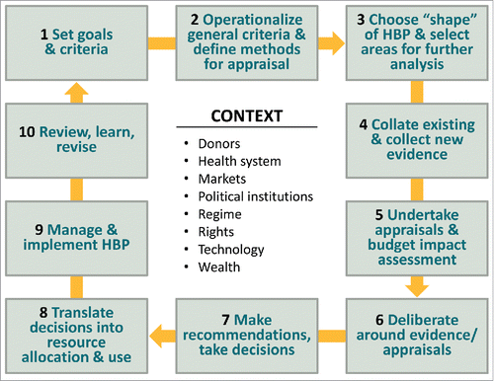
Ten core elements of setting a health benefits plan

Slide 28
Step 1: defining high-level goals and criteria, a job for politicians and stakeholders
Economics
Must protect people against impoverishment
Must be affordable now and in future
Must maximize the number of people with coverage
Must address market failures that result in incomplete insurance
Ethics
Distribution of public spending fair and transparent
Duty to protect most vulnerable
Stewardship of limited resources requires attention to maximizing health benefits
Methods transparent, participatory, equitable, consistent, sensitive to value, responsive to new information, encouraging to innovation
Evidence
Should only support safe, medically effective
Should provide best scientific evidence to clinical decision-making
Should address medical concerns of greatest importance to the “population”
Should facilitate “right care to right patient in the right setting at the right time”
Population Health
Should facilitate efforts to improve population health
Primary, secondary and tertiary prevention needs attention
Access for the vulnerable must be assured
Disparities should be eliminated
HBP
POLITICS
Must be feasible and sustainable politically over time

Slide 29
Step 2: operationalize criteria and define analytical methods, a job for technocrats and academics with input from stakeholders
Criteria start generic –”health”, “financial protection”, “equity”- but then have to be operationalized
  Health measured in deaths, morbidity, severity, QALY, DALY?
  Financial protection using insurance theory: choose high-cost, unpredictable condition-treatment pairs? Financial protection using OOP: perverse incentives?
  Can sometimes be reflected in methods (ECEA, age weighting, poverty weighting)

Slide 30
Step 2: define methods
Methods relate to several pieces of HBP decision-making, but can be set generically for each, always with relation to goals:
  Methods to decide where to start or what next (next step: triage)?
    Elicit stakeholder priorities (health problems, for example) or values/preferences
  Methods to conduct HTA/appraisal, budget impact analysis?
    Reference cases or methods manuals and guidelines
    CEA but beyond CEA too, incorporating constraints of all kinds in models (ie variability in supply capacity)
  Methods to make recommendations?
    Decision rules, thresholds, evidence quality
    Deliberative process, rules of the game

Slide 31
Step 3: choose the “shape of HBP”
    Macro choices that frame scope of HBP, linked to goals and use:
      By type of service or product
      By population group
        How coverage choices interact with HBP (fragmented systems vs universal)
        Capacity to benefit
        Appropriateness criteria
          Example: Avastin® in Ontario only prescribed for rectal cancer - up to 12 cycles
      By level of complexity or facility
      By disease
      By level of subsidy (co-payments, deductibles, coverage caps)
    Also: structuring coding of HBP products and interventions, link to budget/payment reform and structure?
      ICD, DRG, etc.
      International coding system for public health and prevention?
For example:
Uruguay: list organized by type of care, 1 unique list for low and medium level care, one list for high complexity-cost.
Colombia: organized by type of services and associated products in chapters: ambulatory care, hospitalization, oral health, etc.
Chile: by health conditions and care guidelines

Slide 32
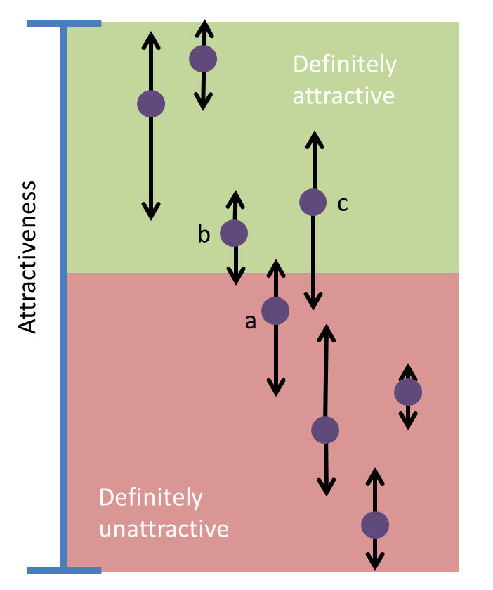
Step 3: select areas for further analysis
India: all services and products currently reimbursed by insurer (RSBY) are included in HBP; all new inclusions will follow new process?
Romania: eliminate all never-evaluated and/or experimental products as first step
DR: eliminate all neighbors’ and NICE “no” products
Thailand: eliminate product (glucosamine) from list for safety reasons

Slide 33
Step 3: what merits further analysis - a lack of process is a common feature in 4 countries
HTA for HBP in selected middle-income countries: How and why topics are selected
Country/Entity | Process for topic selection
Brazil/ANVISA/CITEC | No formal process The definition of priorities has been made through an Annual Workshop on Priorities
Chile/CCA | No formal process. Topic selection is carried out by the CCA
Colombia/CRES | No preestablished process for topic selection In 2011 for the first time a more systematic process was used, but this has not been institutionalized in Colombian Law
Uruguay/FNR/MoH | There is no formal process for topic selection Both the MoH and the FNR define the topics, recent market access drives choice
Thailand/HITAP | Representatives of four groups of stakeholders (health professionals, academics, patient groups, and civil society organizations) are appointed to sit on a panel overseeing intervention prioritization Panel introduces six agreed criteria A scoring approach with well-defined parameters and thresholds employed to address each criterion

Slide 34
Step 4: Data and evidence -- whereas efficacy is global, cost-effectiveness and affordability (and preferences/values) are local
Cost-utility of Trastuzumab expressed as number of GDP per QALY
Bolivia is a middle-income country, but it would cost more than 38 times their annual GDP per capita to purchase a QALY with Trastuzumab

Slide 35
Step 8: Allocate resources consistent with HBP content in every fiscal period
Initial costing and capitation calculations, fit with budget availability overall
Planning to adjust for inflation
Incorporating scale up over time in capitations/payments to lower-capacity providers or local governments

Slide 36
Governance arrangements that frame the cycle are as important as the cycle
Attribute | Examples of good governance | Examples of bad governance
Accountability | NICE is hold accountable by parliament and media on the recommendations it makes | In Mexico, there are no systematic adjustment processes for CAUSES or FPGC In Colombia the executive branch doesn’t explain why certain inclusion decisions were made and whether the BP actually focuses on sanitary goals
Transparency | In Chile, the costing update studies are published and publicly available | Colombia, the original technical priority-setting studies used to design the HBP were lost and nobody really knows how decisions are made and on what criteria. In Uruguay, none of the documents explaining how the universal package was designed is publicly available
Responsiveness | Colombia periodically updates its benefits package | Dominican Republic has never updated its BP since its inception in 2001

Slide 37
Common pitfalls
5

Slide 38
Where things can go wrong – common pitfalls
Failing to account for supply (and other) constraints
Not considering opportunity costs of new inclusions
Legislating specific benefits
Setting up separate high cost drugs packages or funds
Omitting primary care and prevention, fragmenting care
Forgetting about ethics, transparency and process
Allowing indefensible inclusions
Permitting erosion of value over time, divorce from budget process
Missing local data on costs

Slide 39
This limit is imposed by the constrained health care budget
Is the benefit gain from the new treatment greater than the benefit foregone through displacement?
No. Displaced technologies offered better “value for money” (the healthcare system loses “health” and efficiency
Cost-saving (e.g. polio-Sabin vaccine)
Very cost-effective (e.g. U$D 1,000 per QAL)
Relatively good cost-effectiveness (e.g. U$D 5,000 per QALY)
Cost-effective (e.g. U$D 7,500 per QALY)
Cost-effective (but at the limit, e.g. U$D 8,000 or 10,000 per QALY)
New Technology
HBP of an imaginary country where the Ministry of Health (many years ago) defined a cost-effectiveness threshold of U$D 10,000 per QALY in order to consider a technology as cost-effective and allow its incorporation into the benefit plan.
Cost USD: 5,000/QALY
New health technology with a cost-effectiveness ratio of U$D 25,000/QALY
Technologies that will be displaced offered less “value for money”. The benefit gain from the new treatment is greater than the benefit foregone

Slide 40
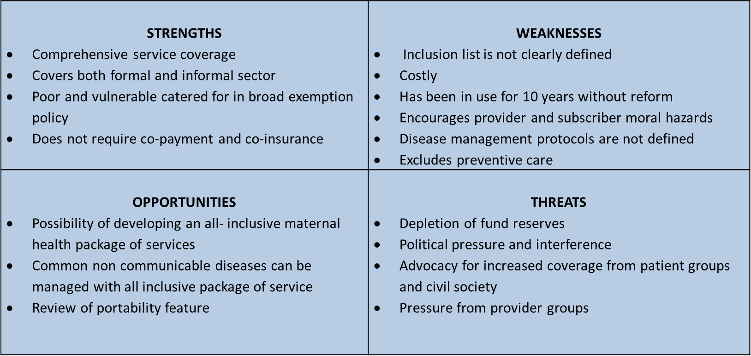
Ghana’s NHIS: legislated benefits, didn’t consider supply capacity, excludes prevention, inconsistent with available resources
Your access to healthcare

Slide 41
Erosion of value: insufficient funding and eroding value in DR and Uganda
  In Uganda, a package of services costing $41 dollars was expected to be delivered at a per capita actual expenditure of $12.50.
  Source: Tashobya et al 2003
Capitation payments to provide BP in Dominican Republic
US$, constant, 2001-2014
Contributory regime
Subsidized regime
Source: Giedion et al 2014

Slide 42
Erosion of value: number of inclusions increase but funding only adjusted for inflation
Evolution of the benefit packages of Seguro Popular, 1996-2012
Change of federal goverment
Legal Reform for the creation of the System of Social Protection in Health
Launch of the Seguro Popular program
Source: Panopoulou for 2013, Sistema de Protección Social en Salud. Informe de Resultados, 2013.

Slide 43
Lack of transparency and formal process
Attribute | Examples of good process | Examples of poor process
Accountability | NICE is hold accountable by parliament and media on the recommendations it makes | In Mexico, there are no systematic adjustment processes for CAUSES or FPGC In Colombia the executive branch doesn’t explain why certain inclusion decisions were made and whether the BP actually focuses on sanitary goals
Transparency | In Chile, the costing update studies are published and publicly available | Colombia, the original technical priority-setting studies used to design the HBP were lost and nobody really knows how decisions are made and on what criteria. In Uruguay, none of the documents explaining how the universal package was designed is publicly available
Responsiveness | Colombia periodically updates its benefits package | Dominican Republic has never updated its BP since its inception in 2001

Slide 44
Main messages
6

Slide 45
Main messages
HBP that will have UHC impact are much more than lists or technical analyses
  Good list is necessary but not sufficient
Effective HBP are a “wrench” that adjust all other control knobs
  Financing, payment, organization, regulation, behavior
They are widely used, but require continual adjustments and reform to enhance effectiveness and assure sustainability
  Not a one-off consultancy, requires permanent home and capacity
Guidance and support from international community mainly focused on cost-effectiveness methods, tools and capacity-building
  Important but need to consider full set of issues
  Multidisciplinary! Health, economics, ethics, fiscal, governance
Process is as important as outcome for effectiveness and sustainability
  Needs to be (widely perceived as) fair, ethical, transparent, defensible in court!
  With a view to manage not ignore legitimate competing interests

