Slide 1
Review evidence to inform the health benefits package reform in Vietnam
Waranya Rattanavipapong
Yot Teerawattananon
Health Intervention and Technology Assessment Program (HITAP)

Slide 2
Background
Health benefits package under the a national Social Health Insurance (SHI) program
Issued in 2009
More than 20,000 items (Medicines, medical devices and medical supplies) are covered in the current package.
The Health Insurance Law enacted in 2008, and a roadmap to achieve UHC was developed in 2012, resulting in a plan to introduce ‘Basic Health Service Package (BHSP)’ by 2018.
Request from Vietnamese Ministry of Health (MOH) to HITAP for technical support on the review of interventions in the benefits package

Slide 3
Selection of priority issues
Criteria for setting priority issues
  Highest budget reimbursed from the Vietnam Social Security (VSS)
  Analysis of claim data from VSS in 2015
  Priority issues are given to the top 20 medicines and 5 medical services reimbursed at national level (1/3 of total VSS budget spent)
Notes:
Social Health Insurance (SHI) scheme overlooked by Vietnam Social Security (VSS)

Slide 4
Process
Step 1: Guidelines & Literature Review
Step 2: Matching indications
Step 3: Clinical Expert Review
Step 4: Developing list of indications

Slide 5
Step 1: Guidelines & Literature Review
  Evidence on safety, efficacy/effectiveness, and cost-effectiveness
Guidelines
  19th WHO Model List of Essential Medicines, Thailand’s National List of Essential Medicines, and Vietnamese guidelines, and other national guidelines or international professional associations
Health-related bibliographic databases
  Medline and Cochrane Library
HTA database
  Centre for Reviews and Dissemination (CRD)
Review protocol

Slide 6
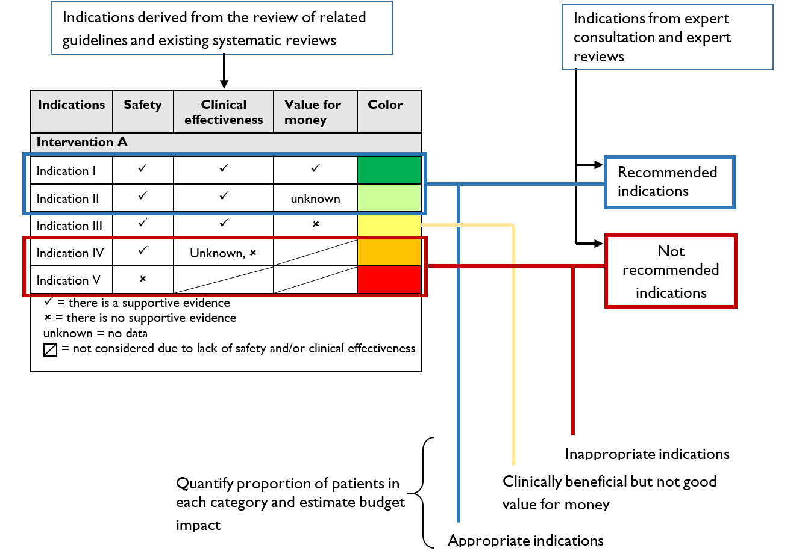
Traffic light system for presenting reviewed evidence

Slide 7
Step 2: Matching indications
Data from 14 hospitals
Top ten indications
  the number of patients who were prescribed any of the selected interventions with known medical indications identified in Step 1.
The analysis aimed to match indications where the prescription of medicines/medical devices were deemed appropriate by the review.

Slide 8
Antibiotic
Indications used in Vietnam | Number of patients | Summary of evidence | Name of supported guidelines
1. Pneumonia | 6,000
Severe pneumonia
Ventilator-associated pneumonia*
Nosocomial pneumonia*
2. Chronic kidney disease | 2,400
3. Rheumatic mitral valve diseases | 2,350
4. Cerebral infarction | 2,300
6. Intracerebral haemorrhage | 1,900
7. Heart failure | 1,700
8. Other sepsis | 1,800
9. Acute myocardial infarction | 1,770
10. Other COPD | 1,590
Others | 3,200

Slide 9
Step 3: Clinical Expert Review
Grey zone
Clinical expert was asked to identify for each of the patient records whether the prescription was justified for the given indication.
The medical indications not identified in the literature review but recommended by clinical experts.

Slide 10
Step 4: Developing list of indications
A list of medical indications for given interventions that should be reimbursed under the BHSP based on the evidence available.
VSS plans to send notice to health facilities on the use with no supporting evidences.

Slide 12
Results (1): reviewed indications for esomeprazole

Slide 13
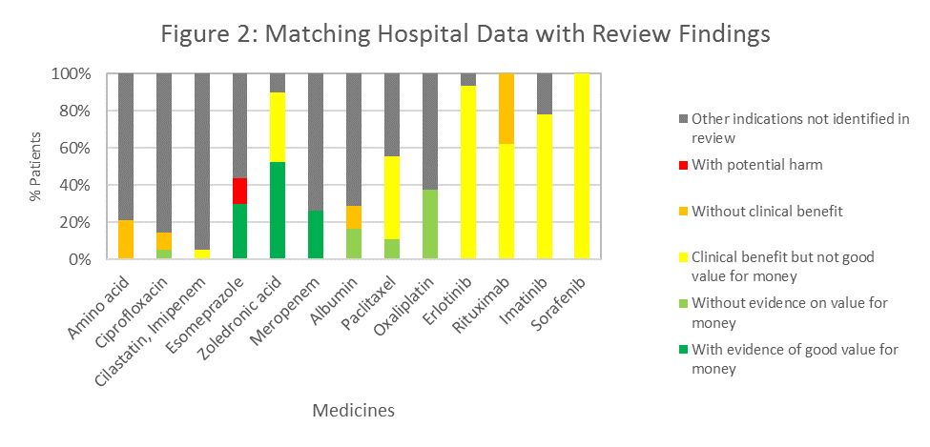
Results (2)

Slide 14
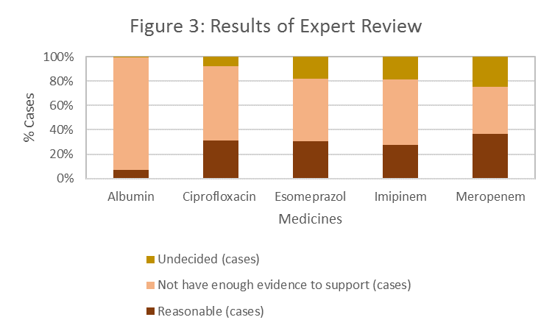
Results (3)

Slide 15
Results (4) Potential saving

Slide 17
FOLLOW US AT

