Slide 1
Malawi’s Health Benefit Package (HBP) Policy
Ministry of Health
Dr. Gerald Manthalu
Deputy Director of Planning and Policy Development
Ministry of Health
March 06, 2017

Slide 2
Contents
Context
Malawi’s HBP Policy
Theory
Reality
Conclusion

Slide 3
Context – Malawi’s health sector (I)
Health Status in Malawi
Health Financing in Malawi
Service Provision in Malawi
Indicator | 2010 | 2016
Total fertility rate | 5.7 | 4.4
Maternal Mortality Ratio | 675/100,000 lb* | 574/100,000 lb
Neonatal Mortality Ratio | 31/1,000 lb* | 27/1,000 lb
% HIV prevalence Rate (ages 15-49) | 10.6
% children fully vaccinated | 80.9 | 75.7
% HH with at least one ITN | 56.8 | 58.9
Highly resource constrained
THE = US$670m (2014/15)
Per capita THE = $39.2 (2014/15)
Highly Donor dependent
Gov. expenditure as % of THE = 28.6% (2014/15)
Lack of risk pooling
HH expenditure as % of THE = 10.9% (8.5% OOP) (2014/15)
No NHIS schemes
Under spending on prevention
Prevention expenditures = 28%
Curative expenditures = 47%
Decentralized three tiered health system
Primary (Health Centre, Dispensary, Maternity unit, Community Hospital)
Secondary (District Hospitals)
Tertiary (Central Hospitals)
Service providers: 9,498 facilities
Public (60%)
CHAM (37%)
Other (3%)
Government policy to have all Malawians within 8km of a health facility
76% 2016 down from 81% 2011
He
* = 2011 lb = live births
Notes:
Health Status:
Very high population – 17 million.
80% rural population.
XXX% live below poverty line.
Improvements in MMR and NMR.
Slight drop in some service provision statistics like % of children fully vaccinated. Slight improvements in others
Health Financing:
Total health sector expenditure was just under $700 m USD in 2014/15
Malawi’s health sector is primarily Donor funded
Malawi has a large informal sector that does not contribute to the general revenue stream through direct taxation
Per capita THE is the lowest in the SADC region which has an average
Malawi does not have the fiscal capacity to meet the desired levels of health expenditure in the health sector.
Development Partner’s contribution of 61.6% of THE is mainly discrete funding or funding under direct donor control. Some of it is ‘on-plan’ but most of it is ‘off-plan’. With such heavy donor reliance, the health financing system in Malawi is unsustainable and unpredictable. Furthermore, planning is made increasingly difficult due to the fragmented system of donor funds and lack of on-budget or pooled funds.
As shown, a large proportion of health sector financing is Donor support. Much of this financing remains programmatic and fragmented. Donor aid often comes at the price of accepting donor commitments to specific objectives. Donors have become less focused on supporting health systems and health sector reform and more on specific programmatic objectives with measurable outcomes.
Given the situation there is a need to develop innovative financing reform options aimed at increasing revenue and improving efficiency, with the aim of reducing donor dependency and moving towards more sustainable financing system.
Service Provision:
The provision of health services has been decentralised, so that the responsibility for service delivery has passed from MoH headquarters to the MoLGRD in accordance with the Decentralisation Policy and Decentralisation Act. Thus, districts have been given greater responsibility for managing health services at district and lower levels.
CHAM and the Government of Malawi have signed a Memorandum of Understanding which is based on the delivery of the EHP for which the government will continue to provide financial support for approved staff establishments, service provision and technical support. The MOH will continue to enter into "service agreements" or "contracts" with some CHAM units so that they provide the EHP "free" of charge at the point of delivery.
Two agencies deliver health care services in Malawi, the MoH, Christian Health Association of Malawi (CHAM), and Ministry of Local Government.

Slide 4
Malawi’s HBP Policy – Theory (I)
First HBP (Essential Health Package (EHP)) developed in 1999 and revised in 2004 and 2011
EHP provided free at the point of access at all public facilities and CHAM facilities with public-private service level agreements (SLAs) in operation
User fees paid for all non-EHP interventions
No legal policy on provision of EHP, only MoH policy
Health system strengthening geared around the delivery of the EHP
Funded from general tax revenue and donor funds
Notes:
EHP was revised every 5 years during the development of Malawi’s health sector medium term plan.
“focus on promoting the provision of a basic, cost-effective package of promotive, preventive and curative health services”
“contribute to reducing poverty, as it addresses the damaging social and environmental conditions that most poor people endure”
SLAs signed with CHAM facilities in catchment areas where there is no overlap with GoM health facilities.
Idea that EHP interventions will be provided ‘free’ at the point of access at all public health facilities and every Malawian is entitled to the interventions.
The EHP addresses the major causes of morbidity and mortality that mainly affect the poor and most vulnerable groups in society.
The policy implies that the government and its partners commit themselves and guarantee that EHP services will be available at all times at government institutions,
Health facilities can provide other health services which are outside the EHP only when there are additional resources available over and above those required to support EHP delivery.
The signing of Service Level Agreements (SLAs) with CHAM facilities for the delivery of Maternal and Neonatal Health (MNH) services is one way of ensuring that the services are accessed by everyone regardless of their socio-economic status
EHP interventions are delivered at different levels of the health system which are linked through a referral chain consisting of a hierarchy of health facilities

Slide 5
Malawi’s HBP Policy – Theory (II)
EHP definition based firstly on Burden of Disease
HIV/AIDS
ARI
Malaria
Diarrhoeal diseases
Perinatal conditions
NCDs including trauma (added 2011)
Tuberculosis
Malnutrition
Cancers (added 2011)
Vaccine preventable diseases
Mental illness and epilepsy (added 2011)
Neglected Tropical Diseases (added 2011)
Eye, ear and skin infections
Conditions were clustered under:
Reproductive
Maternal
Neonatal and Child Health conditions
Communicable Diseases
Non Communicable Diseases
Also defined by level of care each service delivered at:
Dispensary, Health Centre, District Hospital, Central Hospital
78 interventions
Notes:
It’s common for packages to be defined on the basis of a country’s epidemiological and disease profile. The 2004 & 2011 EHP’s ranked the top diseases and conditions to enable an assessment of priority diseases to be included in the EHP. 13 conditions were chosen for inclusion in the 2011 EHP.
Cost-effective interventions are available for most of these diseases and conditions.

Slide 6
Malawi’s HBP Policy – Theory (III)

Slide 7
Malawi’s HBP Policy – Theory (IV)
Following criteria used to define package within 13 conditions
1. Cost effectiveness
2. Access to the poor
3. MDG condition
4. Proven successful intervention – what is this
5. Discrete earmarked funding through bilateral agreements
Notes:
EHP-Technical Working Group responsible for assessing EHP performance and revisions
Within these conditions The EHP Technical Working Group (TWG) used the following criteria for prioritizing interventions for inclusion and the setting of targets in the EHP:
No specific weight ordering

Slide 8
Malawi’s HBP Policy – Reality (I)
Both supply and demand issues with delivery
Supply-side constraints
Financial constraints
Low EHP implementation
Equity issues
Demand-side constraints
Health system constraints
Distance (transport costs & referrals)
Poor health worker attitudes
Patient perception of poor quality
Notes:
While the EHP is suppose to guide free health care provision in an attempt to achieve universal health coverage (UHC), there have been a number of related problems since its inception which have hampered this objective.
UHC is ‘a situation where everyone – irrespective of their ability-to-pay – gets the health services they need in a timely fashion without suffering any undue financial hardship as a result of receiving the care’
For instance, public hospitals (including central, district, and mental hospitals) spent more than any other level of care, with average spending of 35.8%. Primary health care, comprising health centers and clinics, was responsible for only 7.4% of total expenditures. Allocating resources towards primary care is more cost-effective in improving health status but does not provide financial risk protection. This is a major dilemma for low-income countries that cannot finance both. The higher financing to hospital level shows the financing of the EHP has not been followed as the package contains mostly primary care services.

Slide 9
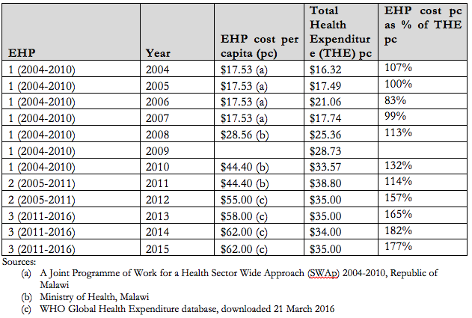
Malawi’s HBP Policy – Reality (II) Supply-side constraints
Financial constraints:
Cost of package > resources envelope
Becoming more unachievable over time
growth in costs has outstripped growth
in resources
Health system constraints:
74% facilities ‘able’ to deliver EHP services
Inadequate human resource capacity (high vacancy rate & uncoordinated in-service training, only 33% of health centre managers knew of the existence of the EHP)
Poorly distributed and dilapidated health infrastructure with inadequate equipment
Insufficient essential medicines and medical supplies (Frequent stock-outs e.g. Cotramoxanidazole only sufficiently stocks in 27% of health centres, ORT (18%), Quinine tablets (20%), Magnesium Sulphate (18%))
Notes:
Even if all resources were used efficiently the EHP would still not be able to cover the full population.

Slide 10
Malawi’s HBP Policy – Reality (III) Supply-side constraints
Low EHP implementation:
EHP interventions not provided to 100% of the population in need
Result is PIN not covered Example intervention (from EHP tool?)
Equity issues
Huge geographical variations in access and care
Care seeking becomes a lottery - when and where you seek care can be the difference between receiving it or not
CHAM SLAs intended to increase access but nearly all SLAs only for maternal & newborn services (not full EHP)
Notes:
Equity:
Interventions are initially financed as if enough resources available, but the budget is eventually exhausted before all the promised interventions are provided in full. This is regularly seen with drug shortages in health centres and districts regularly utilizing between 80-90% of their drug budget half way through the fiscal year.
Another example of this is the variation in the distance to facility. Chitipa where 51% of the population live more than 8km from a health facility, Kasungu (38%), Balaka (32%), Chikwawa and Mangochi (27%) On the other hand, in Chiradzulu, Blantyre, Mulanje and Zomba Districts less than 5% of the population reside more than 8km from a health facility.
These last two issues are really outcomes of the previous two issues – they depict a true conflict of concept as EHP is suppose to be available to every Malawian regardless of where and when they seek care.

Slide 11
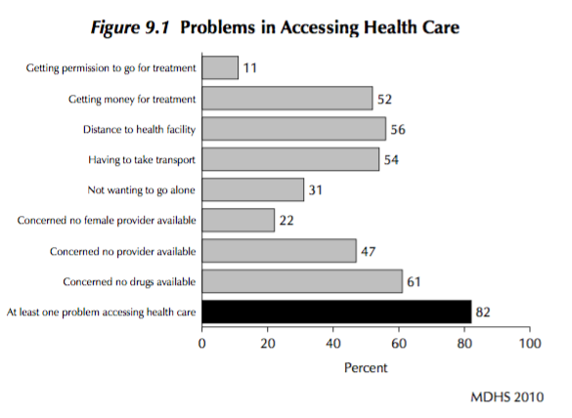
Malawi’s HBP Policy – Reality (V) Demand-side constraints
Distance (transport costs, referrals)
Concern no provider
Concern no drugs
Poor health worker attitudes
Unfairly setting them targets
without means to achieve them
Patient perceived poor quality of
health services
“The government hospital can be
overcrowded and without drugs,
so if other people help you with
money, you go to private hospital”
All above can lead to forgoing or
delaying care seeking or seeking
at private facilities at a cost.
Notes:
to exercise their rights and to be aware of the correct channels to complain about poor services
In rural Malawi, these access-related gaps have led to low satisfaction with services provided by public facilities, and hence, a high preference for private/CHAM facilities, as already reported in previous studies. This further widens gaps in financial protection, since the private/CHAM facilities collect out-of-pocket payments.
Many of the demand-side issues also stem from the EHP policy. Distance can be increased as the closest health centres don’t have drugs. Poor health worker attitudes can stem from the inability to provide care due to lack of essential medicines and equipment. All these affect the perception of public health services and thereby demand for care.

Slide 12
Malawi’s HBP Policy – Reality (VI)
The demand- & supply-side constraints prevent the EHP being fully implemented
A number of other issues affecting both development & implementation of EHP:
Donor dependency + primarily off-budget support:
Government doesn’t always have decision making ability about where funds are spent. Donor objectives often supersede government priorities
Payment:
EHP supposed to link to both planning and funding of health service delivery – no reimbursement mechanisms prioritizing provision of EHP interventions ➔ everything is delivered free
Essential medicines list linked to EHP which means health facilities can only order medicines within the package (is this true? Ask Gerry what the current reality is) - This is to ensure that essential drugs and supplies necessary for the delivery of EHP interventions are always available in adequate quantities. But this does not happen.
A district expenditure tracking study estimated that approximately 20% of resources are spent on non-EHP conditions.
CHAM SLAs for EHP provision paid on fee-for-service (supplier-induced demand)
Notes:
Ultimately the fact that the EHP costs more to deliver than the resources available is setting up to fail. Most of the other issues stem from this problem and this is the initial one that should be solved before any of the others can be addressed.
The health sector embarked on the process of decentralisation, which resulted in devolution of the drug budget to districts in 2006. Recentralised but orders still devolved. Now facilities just order with no reference to budgets.

Slide 13
Conclusion
Both Design and Implementation challenges
ignoring the inherent trade-off between population covered and interventions included (subsequent consequences for access and financial risk protection)
Interventions patients are entitled to ≠ Interventions patients receive in practice
Currently the EHP is a notional package of basic services where the package listed on policy documents does not reflect the reality of what is actually provided?
The EHP has created a universal sense of entitlements to free health care at the point of use
Malawi currently in last stage of revision of it’s EHP (2016)
While CEA again used as the primary methodology, used differently from previous revisions
Malawi’s experience using CEA this time will be presented tomorrow
Notes:
Patients frequently being compelled by circumstances to seek care at CHAM/private facilities, incurring OOP

Slide 14
Sources
Malawi Demographic and Health Survey (2010 & 2015)
Ministry of Health – Planning Department & World Health Organization ‘National Health Accounts’ (2016)
Ministry of Health – Planning Department (2016) ‘Resource Mapping’
Ministry of Health – Planning Department (2011) ‘Malawi Health Sector Strategic Plan 2011–2016 Moving towards equity and quality’
Ministry of Finance - Economic Planning and Development (2015) ‘Malawi Millennium Development Goals (MDGs) Endline Report’
Kazanga, I., (2015) ‘Equity of access to Essential Health Package (EHP) in Malawi: A perspective on update of maternal health services’
Mwase, T. et al. (2010) ‘District Health Expenditure Patterns Study’
Mueller, D. et al. (2011) ‘Constraints to Implementing the Essential Health Package in Malawi’, PLOS One
Abiiro, G. et al. (2014) ‘Gaps in universal health coverage in Malawi: A qualitative study in rural communities’, BMC
Ministry of Health – Planning Department (2004) ‘Handbook and guide for health providers on the Essential Health Package (EHP) in Malawi: Understanding the EHP’
Ministry of Health - Planning Department (2004) ‘A Joint Programme of Work For A Health Sector Wide Approach (SWAp) [2004–2010]’
Chirwa, ML. et al. (2013) ‘Promoting universal financial protection: contracting faith-based health facilities to expand access–lessons learned from Malawi’ Health Research Policy & Systems
Ministry of Health – Planning Department (2017) ‘Health Sector Strategic Plan II [2017-2022] Situation Analysis.’
Ministry of Health & USAID (2014) ‘Malawi Service Provision Assessment 2013/14 (SPA)’

Slide 15
Malawi’s HBP Policy – Theory (III)
EHP Condition | Intervention
HIV/AIDS/STIs | Multi level BCC across all sectors Health promotion Screening (HIV testing and counselling through all entry points) Provision of home based care Procurement and provision of male and female condoms Provision of ART Provision of PMTCT services CPT Blood and needle safety STIs - Screening and treatment and promotion Treatment of opportunistic infections Peer and education Programs for high risk groups Condom promotion and distribution
ARIs | Health promotion on recognition of danger signs for ARIs Early treatment of ARIs using standard protocols Treatment of pneumonia
Malaria | Health promotion Early treatment of malaria at household, community and health centre level Promotion and use of LLITNs Promotion and use of IRS Vector control - Larvaciding and control of breeding sites IPT pregnancy
Notes:
These interventions don’t quite line up with the 78 referenced earlier – this is another problem…..it is unclear what the interventions actually in the package are.

Slide 16
EHP Condition | Intervention
Diarrhoeal diseases | Health promotion Early care seeking – use of ORT Provision of zinc Construction of low cost excreta disposal Provision of home solutions Promotion of exclusive breastfeeding Surveillance of water and food quality
Adverse Maternal and Neonatal outcomes | Health promotion Promotion and provision of family planning methods Promotion of institutional deliveries Provision of services for complications of delivery (BEmONC and EmoNC) Screening for cervical cancer using VIA Repair of obstetric fistula
NCDs and trauma | Health promotion on awareness about health risks such as smoking and drinking of alcohol, safe driving and gender based violence Screening for risk factors and conditions (cardiovascular, diabetes) Promote physical activity Promote healthy diets Community and facility based rehabilitation, first aid
Tuberculosis | Community DOTS Health promotion Treatment of TB including MDR
Cancers | Health promotion Early screening (cervical and breast cancer, Kaposi’s sarcoma) Treatment with cryotherapy and surgery (scaling up)

Slide 17
Malawi’s HBP Policy – Theory (V)
EHP Condition | Intervention
Vaccine preventable diseases | Health promotion Pentavalent Polio Tuberculosis Measles Tetanus
Mental illness including epilepsy | Health promotion interventions to create awareness about mental health Mental health promotion in schools and workplaces Treatment of epilepsy Treatment of acute neuropsychiatric conditions – inpatient Rehabilitation
NTDs | Case finding and treatment of Trypanosomiasis LF mass drug administration Mass drug administration for onchocerciasis STH mass drug administration in school children Mass drug administration
Eye, ear and skin infections | Health promotion on prevention of eye, ear and skin infections Treatment of conjunctivitis, acute otitis media, scabies and trachoma

Slide 18
Malawi’s Experience with Cost-Effectiveness Analysis (CEA)
Ministry of Health
Finn McGuire
ODI Fellow
Department of Planning and Policy Development
Ministry of Health
March 08, 2017

Slide 19
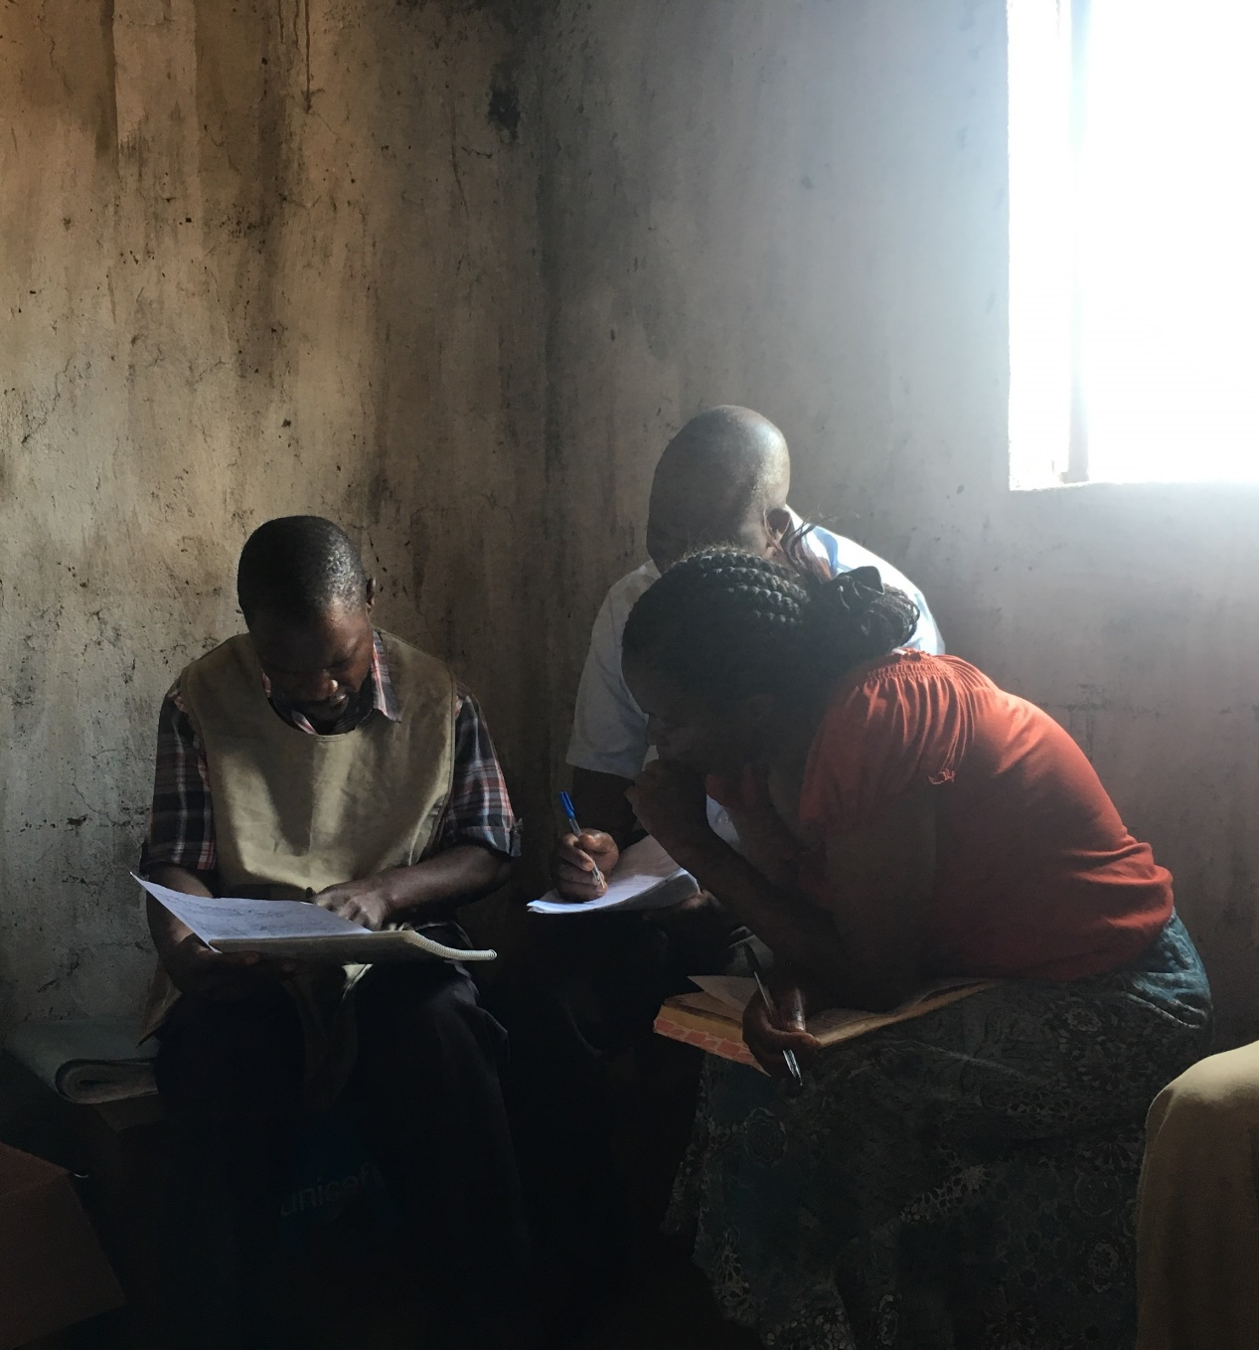
Contents
Context
EHP/BHP Definition
Process
Quick Cost-Effectiveness Analysis (CEA) reminder
Malawi’s CEA methodology
Where are we now?
Lessons
Conclusion
Notes:
Although Malawi has had experience using CEA in the past to define and revise its HBP, I’m going to talk about the experience using it for the most recent and on-going revision.

Slide 20
Context for revising the EHP/BHP
Key Issues
Solution
No clear Objective
No clear criteria or criteria misused for inclusion/exclusion of interventions
Outdated: needs to be constantly revised to reflect budgetary and technology changes
Financially unachievable
Inequitable
Ignores inherent trade-off between population covered & interventions included
Clearly define objective
Set clear intervention inclusion/exclusion criteria
Update data
Define a financially achievable package
Ensure equity
Ensure understanding of trade-offs and follow logic of objective defined in decision making
Notes:
Gerry outlined some of the issues faced yesterday.
Most of these issues are inter-related. For instance, the inequity is caused by the package being financially unachievable and the package being financially unachievable is caused by ignoring the trade-off between the population covered and interventions included.

Slide 21
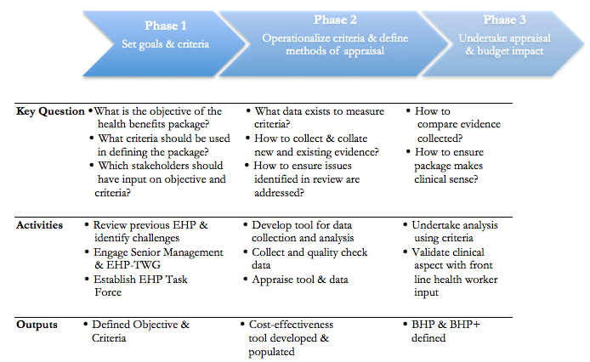
BHP Definition – Process (I)
Names matter
Essential Health Package (EHP) ➔ Basic Health Package (BHP)
Process equally as important as methodology used in assessments
Deliberative process rather than consultative
Notes:
Before go into anything mention that one of first things did was change the name from the EHP to the BHP (give reason)
When talk about the EHP I mean the past package and when talk about the BHP current package
Not going to talk as much about the process, because the focus is on the methodology but as has been stated numerous times so far the process is equally as important as the methodology
A deliberative process rather than a consultative one. Planning Dept. facilitated discussions and aided with provision of evidence. But other stakeholders made decisions (technical departments).

Slide 22
BHP Definition – Process (II)
Goal of the BHP
Inclusion criteria
Consequences of including other criteria
Goal is to maximise population health
Consistent with the Mission of the Malawian Ministry of Health
Where goal is to maximize health CEA typically used.
Enables prioritization of interventions in way that maximizes population health under a constrained budget
Health Maximisation (costs, effects, BoD, affordability, feasibility)
Equity (women, children, disadvantaged populations – not all DALYs are equal)
Continuum of Care
Complementarities
Extraordinary donor funding
Maximising (with budget constraint) means achieving efficiency
Efficiency should always be tempered by considerations of equity (in both process & outcome)
Multiple maximand requires trade-offs
Health loss for gains in other criteria
Notes:
Goal of the BHP:
Decided the goal was to maximise health
This was consistent with the mission of the Ministry of Health in Malawi which is to “raise the health profile of all the people of Malawi”
Inclusion Criteria:
If 2 equally cost-effective interventions provided the same number of DALYs to men or women or children we prioritised latter.
Decision to leave out Donor funding as a key inclusion criteria – because donor funding often unpredictable and if donors pulled out GoM would then be liable to deliver intervention.
The practicalities of implementing some of the criteria in the decision making process were difficult (data). Often just considered informally, as part of the decision making process.
Consequences of including other criteria:
Because CEA necessarily maximizes total health, the incorporation of other considerations that change resource allocation decisions necessarily results in lower total health.
CEA can therefore enable us to quantify the health opportunity costs, in terms of reduced total health, of imposing these additional constraints.

Slide 23
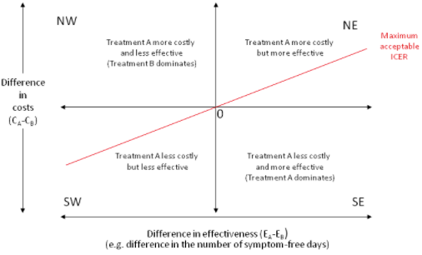
Quick CEA reminder
Data requirements:
Estimate of health gain (Disability Adjusted Life Year (DALY))
Estimate of cost
Health expected to be lost because of the cost (cost-effectiveness threshold)
Intervention cost-effective if:
ICER: ΔC/ΔH < k
Net Health Benefit: ΔH – ΔC/k > 0
*k = cost-effectiveness threshold
Notes:
Just a quick reminder on CEA
The basic framework of any cost-effectiveness analysis is similar. Requires information on the costs of interventions, effectiveness of interventions, which is measured using Disability Adjusted Life Years or DALYs, generalized measure of health outcome which allows for comparability across interventions.
And a cost-effectiveness threshold
Cost-effectiveness plane

Slide 24
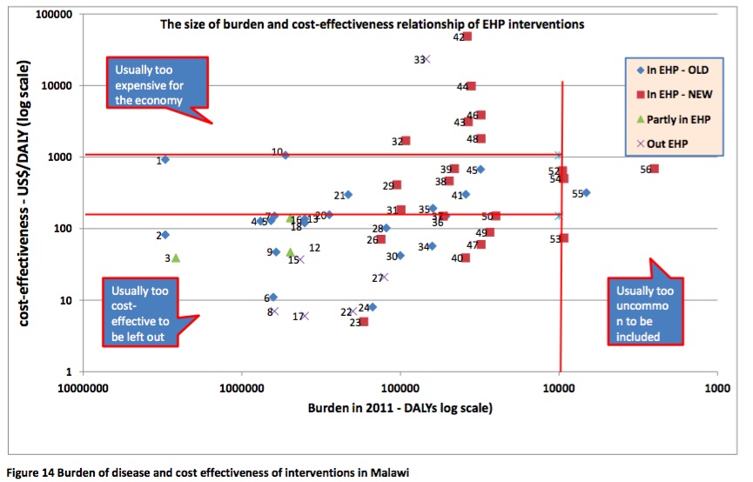
BHP Definition– CEA(I)
Malawi used CEA in it’s definition of the EHP
Steps in defining EHP:
Assess BoD
include conditions with >10,000 DALYs per year
Include cost-effective interventions which treat these conditions (DCP2 used)
Interventions ‘cost-effective’ if cost/DALY averted < 3X GDP per capita ($1050/DALY averted (WHO-CHOICE cost-effectiveness threshold)
Notes:
As mentioned Malawi previously used CEA to define the EHP
First it chose the conditions to focus on by assessing the BoD. Conditions with over 10,000 DALYs per years were considered for inclusion.
Then assessed the cost-effectiveness of interventions addressing these conditions. Interventions were deemed cost-effective if they cost less than $1050 per DALY averted which is 3x GDP per capita, WHO-CHOICE’s recommendation for the threshold. Issues around this have already been discussed.

Slide 25
BHP Definition– CEA(II)
Previous methodological issues:
Concept of cost-effectiveness threshold (CET) misused
Assessing BoD first and cost-effectiveness of intervention second
No prioritisation within EHP interventions
Doesn’t reflect additional supply and demand constraints on implementation levels
Notes:
However, we found lots of problems with this methodology
Firstly the concept of a the CE threshold was misused.
The order of assessing BoD first and then only looking at interventions which address these conditions means that you potentially miss cost-effective interventions which address other conditions and risk not maximising health.
There was no prioritisation within the cost-effective interventions.
And lastly, the methodology didn’t reflect supply and demand constraints on implementation levels

Slide 26
BHP Definition– CEA(III)
New cost-effectiveness framework developed addressing these issues
CET should represent the opportunity cost of health care spending
Health forgone by spending on an intervention as this could have been spent elsewhere
A supply-side concept about what the health system can provide given resource constraints
NOT a demand side concept as this is not based on the reality of the resource constraint (WHO-CHOICE)
Notes:
CET should be context specific and account for the health sector budget. Specifically should represent the opportunity cost of health care spending.
Demand side concept might be useful in giving information on how large the budget should be in the health sector but does not help once a budget has been decided.
Very little work has gone into the estimation of CET thresholds in developing countries
Two studies that provide a range of estimates of health opportunity costs for Malawi, reflecting alternative estimation methods and assumptions. Woods et al. estimate the threshold to range between $3 and $116 per DALY averted which is between 1 and 51% of GDP per capita; and Ochalek et al. give estimates ranging from $24 and $37 per DALY averted, or 11 to 16% of GDP per capita. Much lower than the previously used threshold of between 1-3 times GDP per captia.
Chose the mean of the two so threshold set at $61/DALY averted.
The key notion of Opportunity Costs – If resources are spent on one intervention or programme, they are foregone for use in providing other alternatives.
Opportunity Costs are the value of the next best alternative
rate at which the Malawian health system is currently able to generate health improvement from its expenditure
or, put another way, the health forgone by spending on an intervention as this could have been spent elsewhere

Slide 27
BHP Definition– CEA(IV)
2 Step process
Define which interventions are cost-effective for EHP by ranking interventions according to ICERs. Interventions with ICERs below threshold are cost-effective
ICERs cannot prioritise between interventions. Prioritization done by ranking cost-effective interventions by population health effect
Notes:
We wanted to move away from looking at BoD and make cost-effectiveness decisions based on interventions.
Can have a condition with a very high BOD but no cost-effective or even efficacious interventions.
(Slide)

Slide 28
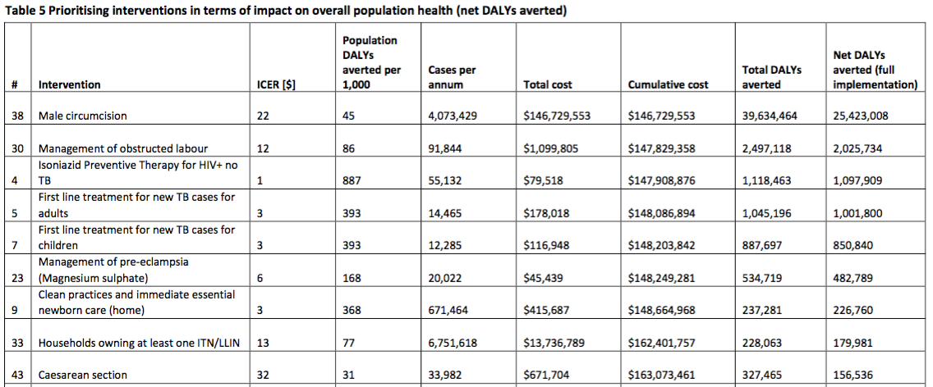
BHP Definition– CEA(V)
Notes:
Theoretically should work your way down the list including all interventions in the package until you reach intervention where the net DALYs averted of including is 0. This would mean including all interventions with ICERs less than $61/DALY averted in our case.
Turns out a CET of $61/DALY averted is too high…..if we included all the interventions with ICERs less than $61 then the package cost is $250M +. We only had a budget of $168M+....
This means that the CET in Malawi is likely actually lower than $61/DALY.
So we decided that working down the list until your budget is exhausted as the next best option.
Mention Only drug and commodity cost (no input costs of infrastructure, human resources, medical equipment etc.) included in cost of interventions. So compared this against Malawi’s budget for drugs and commodities

Slide 29
BHP Definition– CEA(VI)
Budget not only constraint, also non-financial (health-system) constraints
Results in < 100% implementation
New framework quantifies the population health impact of intervention-specific and system-level constraints (taking current implementation levels)
Net DALYs averted decrease and (in some cases) there is budget underspend as less patients receive intervention
Provides policy makers with a $ value of intervention specific HSS (but does not provide indication beyond this)
Another constraint: earmarked funding causes budget silos (adaptation of methodology needed)
Ideally want to disaggregate exercise to each budget silo e.g. budget allocated to nutrition, TB, HIV etc.
Prevents health maximisation – different marginal rates of substitution
Notes:
Also supply side health system constraints that can prevent an intervention being fully implemented, even if it is within the financial capacity of the health system.
The framework allows us to quantify the health impact of these constraints which allows us to identify the maximum amount we should invest in health system strengthening to address these constraints.
But in reality we didn’t consider the implementation levels when choosing interventions for inclusion in the package. This will take some more though in terms of how to operationalise this information.

Slide 30
BHP Definition– CEA(VII)
Decision to define two packages:
BHP - primary function is purchasing and provision
BHP+ - concerned with resource mobilization
BHP financially unaffordable but cost 42% less than EHP
BHP DALYs averted = 23 million
EHP DALYs averted = 20 million
Criteria not strictly stuck to in process
Cost of BHP+
US$440M
Cost of BHP
US$228M
Resources available
US$168M
Notes:
So once we took the methodology to decision makers what happened.
Malawi had a budget of $168M for drugs and commodities in 2015/2016FY.
Decided to create two packages – one for purchasing and actual provision and one for resource mobilization.
Even though the BHP is still financially unaffordable to provide to 100% of the PIN, it cost 42% less than the EHP. So movements in the right direction.
Similarly the BHP averts 3 million more DALYs than the EHP if provided to 100% of the PIN – so theoretically (stress) does more for less. Bit of a bargain.
BHP costs US$228M and averted 23 million DALYs
EHP cost US$408M and would only have averted 20 million DALYs
BHP+ costs US$440M and averts 65 million DALYs

Slide 31
Where are we now?
Haven’t achieved anything yet in terms of implementation
MUST link payment mechanism to package or clinicians have final say at delivery (outcome = ad hoc rationing)
Number of programmatic NSPs which ignore BHP
Malaria – IRS, Lavaciding & HIV – VMC
Need for alignment
Rationing on paper is hard but even harder to translate into actual resource allocation
Notes:
Haven’t achieved anything yet.
Talk about next steps and linking package provision
Standard Treatment Guidelines, Essential Medicines Lists, Trainings,

Slide 32
Lessons - Methodology
The analytical framework has huge data requirements (only had 87/250+ interventions with full data)
Disagreements with cost-effectiveness estimates
Issues with classifying interventions
Defining lists and costing interventions are two very different processes
Want interventions to be disaggregated as much as possible while maintaining clinical acceptability
Using interventions split by costing method not clinically acceptable
EHP suffered from the opposite problem (e.g. ‘mass treatment of neglected tropical diseases’)
Organizations (unnamed) recommend using CEA but their actual methodology is unclear
Their recommendations are often wrong – 1-3 times GDP per capita as threshold…..$150-$1050 / DALY averted
Risks lowering population health
CET for Malawi likely much lower
Ultimately, ‘within’ country analyses likely to be necessary to get fully informative CETs.
Notes:
Huge data requirements
BoD data for instance is from a 2008 study of the burden at a central hospital and then extrapolated out. So lots of the data used not perfect.
Opposite case the mass treatment of neglected tropical diseases was considered for inclusion in the EHP because it is cost-effective at under $10 per DALY while dealing with a disease burden of over 100,000 DALYs
Previous package gives the false impression of taking interventions away

Slide 33
Lessons - Process
Generating consensus is harder when structures are vertical
Multiple constraints (budget, health system, earmarked funding/budget silos) - very difficult to account for all of them in decision making
Information is not all powerful - preconceptions can be more persuasive than data
While agreeing theoretically to a set of criteria is straight forward, sticking to their logic in decisions isn’t
While ‘essential lists’ might be useful for guiding health systems in a general sense or for resource mobilization. They can be damaging for planning purposes
While the agreed stated objective was to provide the BHP to all in need the decisions taken don’t reflect this (stronger competing objective?)
There is a ‘minimum package’ within which people are unwilling to ration
Doesn’t matter that inclusion in the package doesn’t mean delivery on the ground (the unwillingness to remove remains)
A saturation point is reached
Unfortunately this ‘minimum package’ costs more than the resources we have available in Malawi
Notes:
Generating consensus is harder when structures are vertical
Multiple constraints (budget, health system, earmarked funding/budget silos) - very difficult to account for all of them in decision making
Preconceptions - Male circumcision example (out of package). To be totally honest a good thing or, due to the cost, we would be an entire health system dedicated solely to performing VMC. The first of it’s kind.
Once difficult trade-offs are faced people tend to fail to stick to previous logic, often doing so by failing to make a decision altogether.
Given decisions taken, we can only conclude that some ad hoc rationing is a more desirable situation than out-right not providing some treatments (for some people at least).
Guides like the WHOs standardised list of ‘must have medicines’ and ‘essential interventions’ have pervaded thinking. These generalised lists and guidelines are devised without any reference to a budget and are damaging to planning processes. Things like WHOs minimum package of essential interventions (based on its minimum recommended health care spend per capita [US$84]) might be good for advocacy but are potentially damaging for countries who’s health sector spends less than that.
Rather than these types of prescriptive stances, guidance should be provided based on best practice methodology
Easier to ration preventive than inpatient care (less population health gain but more financial risk protection)
Allocating resources towards primary care is more cost-effective in improving health status but does not provide financial risk protection. This is a major dilemma for low-income countries that cannot finance both. When it becomes clear that countries discover that they lack the public resources to fund both primary care and hospital services, most decide to continue to fund hospital care.

Slide 34
Conclusion
Resource allocation and rationing in a HIGHLY resource constrained setting is challenging
Can use CEA but if used inappropriately it won’t achieve desired objective (maximise health)
Further, even using correct CEA methodology does not guarantee achieving objectives
Process is equally important
Starting point is to ensure correct & defensible methodology and ensure process is consistent, transparent and accountable
Notes:
Resource allocation and rationing in extremely resource constrained contexts is challenging. However, arguably more important than in other settings
CEA is a useful tool if your objective is to maximise population health, but unless the methodology is correct, this won’t be achieved.
From Malawi’s experience it is also clear that getting the methodology right is a necessary but not a sufficient condition for achieving the objectives intended. The process is equally important.
It is very easy to set criteria which will theoretically guide decision making. However, sticking to them once in the process of inclusion/exclusion decisions is difficult.
In many ways fixing the methodology is the easy part, the hard part is ensuring the process sticks to the methodology.
We set about revising the methodology, under the premise that what had been holding back the EHP was the lack of affordability and poor implementation. Worked under the assumption that once methodology sorted we could engage stakeholders and undertake the process of revision in a participatory manner. Unfortunately we found buy in hard to achieve. There was a view that this was a technical exercise which planning dept. should undertake and come back with proposals.
None the less, process has happened, there have been improvements in the package (at the very least) and the next steps will be to link the necessary health system elements to the provision of the package. Whether this was the right way round to undertake things, I’m not sure, but we felt that there was no reason to link financing, for instance, to a package which was entirely aspirational…..but this is still the case.

Slide 35
Sources
World Bank (2006) ‘Disease Control Priorities in Developing Countries’ 2nd edition
Ochalek, J. (2016) ‘Supporting the development of an essential health package: principles and initial assessment for Malawi’ CHE Research Paper 136
Ministry of Health – Planning Department (2017) ‘Health Sector Strategic Plan II (2017-2022) Situation Analysis’
Phoya, A. (2014) ‘Setting Strategic Health Sector Priorities in Malawi’ Disease Control Priorities in Developing Countries, 3rd Edition Working Paper #9
Ochalek, J. et al. (2016) ‘Toward the Development of an EHP for Malawi’
Woods, B. et al. (2015) ‘Country-Level Cost
Revill, P. et al. (2014) ‘Using cost-effectiveness thresholds to determine value for money in low- and middle-income country healthcare systems: Are current international norms fit for purpose’ CHE Research Paper 98
Ochalek, J. et al. (2015) ‘Cost per DALY averted thresholds for low- and middle-income countries: Evidence from cross country data’ CHE Research Paper 122
Claxton, K. et al. (2015) ‘Methods for the estimation of the National Institute of Health and Care Excellence cost-effectiveness threshold’, Health Technology Assessment, (19)14
Notes:
Partly to do with the setting of the CET is still too high (if we simply rank interventions by CE and go down including interventions until budget is exhausted the last intervention chosen has a CEness of $XX
Even NHS doesn’t ration as much as it should
This is not a unique problem – even the UK is unwilling to ration health care to the extent it should financially. While NICE doesn’t have a completely set CET it is usually said ….The CET is between $25,000-$35,000 while evidence suggests it should be closer to $12,000 (Claxton et al., 2015). This contributes to the need for wait time rationing.

