Slide 1
Methodological options for setting the health benefits package
Peter C. Smith
Imperial College London and
International Decision Support Initiative

Slide 2
“Nobody knew that healthcare could be so complicated.”
Donald J. Trump, 27 February 2017

Slide 3
Purpose of this session
To explain the role, the strengths and the limitations of analytic methods in informing the specification of the health benefits package
To explore the most promising avenues for future development of methods
Not intended as a methods tutorial

Slide 4
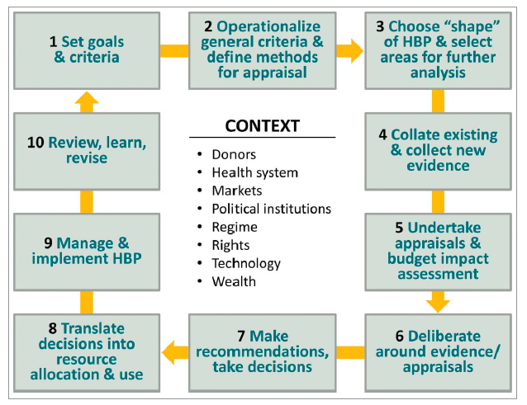
Ten Core Elements of Setting a Health Benefits Package
Glassman, A., Giedion, U., Sakuma, Y. and Smith, P. (2016), “Creating a health benefits package: what are the necessary processes?”, Health Systems and Reform, 2(1), 31-50.

Slide 5
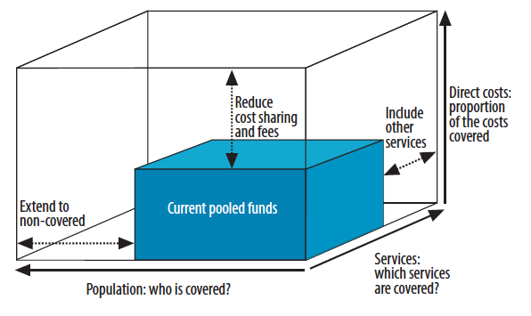
Three dimensions to consider when moving towards universal coverage
World Health Organization (2010), World Health Report 2010, WHO: Geneva

Slide 6
The role of analytic methods in informing the HBP
Creation of HBP serious issue, with consequences for the health, life prospects and finances of affected individuals
Ultimately a profound political problem
Analytic methods can contribute by:
  Acting as a ‘referee’ between competing claims for limited resources
  Protecting politicians and other policy makers from impossible demands of competing claims for health services
  Clarifying priorities and trade-offs (e.g. equity)
  Facilitating accountability, transparency and consistency
  Using evidence to best effect
  Focusing attention where it is most needed
  Demonstrating that health service funds are spent wisely

Slide 7
Analytic methods in context
Should always be informed by legitimate policy choices
Their key role is to apply chosen criteria consistently and universally
Methods seek to maximize the ‘value’ obtained from limited health system resources
Transparency should be intrinsic to analysis
Recognize limitations to data, research and analytic capacity
Analytic evidence should usually be considered alongside other contextual evidence and constraints.

Slide 8
Key choices when applying analytic methods
What is ‘value’?
  Health
  Financial protection
  Other
What are available resources?
What are other constraints to choices?
How is ‘equity’ to be interpreted?
What time period is under consideration?

Slide 9
The key concept of ‘opportunity cost’
Whatever methods are used, some groups will gain (from inclusions in the HBP) and others will lose (through exclusions from the HBP)
Gains from inclusions may be reflected in:
  health (access to services that would not otherwise have been available)
  finance (zero charges for services that would otherwise be charged for)
These gains must be compared with the opportunity costs for those whose medical needs are excluded from the HBP
‘Externalities’ and other considerations complicate matters for infectious diseases

Slide 10
Outline of methods
Cost-effectiveness analysis
  Measurement of health benefits
  Measurement of costs
  The cost-effectiveness threshold
Extended cost-effectiveness analysis
Multiple objectives
Non-budgetary constraints
Assessment of evidence relevance and limitations
Setting analytic priorities

Slide 11
1. Cost-effectiveness analysis (CEA)
Based on the principle of constrained maximization of benefits with respect to a fixed budget
Seeking to capture the incremental costs and benefits of a health service intervention
So must always evaluate with respect to a comparator (which may often be ‘do nothing’)
Usually assumes interventions are independent of each other
The incremental cost-effectiveness ratio (ICER) is a key metric for any intervention
Interventions are ranked according to their ICERs, and included until the budget is exhausted
Resources:
  Drummond, Michael F., Mark J. Sculpher, George W. Torrance, Bernie J. O’Brien, and Greg L. Stoddart. Methods for the Economic Evaluation of Health Care Programmes. 3 edition. Oxford; New York: Oxford University Press, 2005.
  Jamison, Dean T., Joel G. Breman, Anthony R. Measham, George Alleyne, Mariam Claeson, David B. Evans, Prabhat Jha, Anne Mills, and Philip Musgrove. Disease Control Priorities in Developing Countries. The International Bank for Reconstruction and Development / The World Bank, 2006. https://www.ncbi.nlm.nih.gov/books/NBK11728/

Slide 12
CEA – Measuring benefits
Challenging to model lifetime health gains, but methods well developed for many NCDs; increasing use for infectious diseases
Generally accepted principles of quality-adjusted life years (QALYs) or DALYs
  Life expectancy
  Health-related quality of life
Have to make some assumption about ‘quality’ (effectiveness of service delivery)
Health gains to identical individuals should be universally similar (subject to similar service quality) so benefits calculations often transferrable between settings
Special challenges for infectious diseases
  Externalities
  Dependent on epidemiology, behaviour etc

Slide 13
CEA – Measuring costs
In principle should seek out opportunity costs
Accounting costs usually used as a proxy
Cost structures complex for many health services
  Much early CEA work on pharmaceuticals, for which infrastructure costs relatively low
  Infrastructure costs shared by many interventions
  Economies of scale and scope
  Often highly dependent on local service organization, so may not be readily transferrable between settings
Costing tools beginning to emerge:
  WHO OneHealth http://www.who.int/choice/onehealthtool/en/
  JLN Costing Toolkit http://www.jointlearningnetwork.org/resources/costing-manual-tool-kit
Costing also essential for
  calculating budget impact
  pricing and provider payment

Slide 14
CEA – the cost-effectiveness threshold
The threshold indicates the ICER of the marginal intervention, just included in the HBP
Any intervention with a higher ICER should be excluded
The level of the threshold depends on a country’s epidemiology, budget availability, and the range of therapies under consideration
The threshold is useful because it acts as a rigorous rule of thumb for considering interventions piecemeal, not requiring re-assessment of the entire HBP
The level of the threshold may change (reduce) if a treatment with high budget impact is introduced into the HBP

Slide 15
Quantifying and handling uncertainty in CEA
Uncertainty intrinsic to all analysis
Can arise from numerous sources:
  Limitations in evidence from cost-effectiveness studies (e.g. sample size; target population; country setting; date of study)
  Limitations in modelling methods used (model structure, parameters used)
  Uncertainty about effectiveness with which health services will be delivered
  Uncertainty about which population groups will use the treatment and heterogeneity in their benefits or costs
Increasingly sophisticated methods for modelling and presenting uncertainty
Often an important factor in decision-making, especially when deferral of decision is possible
Griffin, S. and Claxton, K. “Analyzing uncertainty in cost-effectiveness for decision-making”, in Glied, S. and Smith, P. (eds) (2011), The Oxford handbook of health economics, Oxford: Oxford University Press.

Slide 16
2. Extended CEA
(Verguet and Jamison chapter)
Extends the principle of conventional CEA to reflect (a) equity and (b) financial protection
Calculates measures of financial loss averted by including the treatment in the HBP
Reports health gains and financial gains by income group
Leaves reporting disaggregated to allow decision-makers to take the different outcomes into account – does not seek to summarize benefits

Slide 17
Stylized example of ECEA from Verguet and Jamison

Slide 18
3. Multiple objectives in CEA
(Morton and Lauer chapter)
Increased interest in ‘multi-criteria decision analysis’ (MCDA)
Reflects concern that health improvement may not be the only objective of concern
  E.g. workforce productivity
ECEA first steps toward a theoretically coherent approach
MCDA a more heuristic and flexible approach that allows inclusion and aggregation of multiple objectives
  Well-established outside health care sector
  Guidelines on good practice

Slide 19
Issues with implementing MCDA
Who should influence choice and weight of criteria?
What should those criteria be?
How should attainment on the criteria be measured?
What should be the weight placed on each additional unit of attainment for each criterion?
Can MCDA be applied to all interventions under consideration?
Profound methodological challenges
Profound implementation challenges

Slide 20
From Morton and
Lauer chapter

Slide 21
4. Non-budgetary constraints
(Hauck, Thomas and Smith chapter)
Six categories of impediment to implementing CEA recommendations:
  Design of the health system (eg human resource constraints)
  Costs of implementing change
  System interdependencies between interventions (eg shared platforms)
  Uncertainty
  Weak governance
  Political constraints

Slide 22
An example: system interdependencies

Slide 24
5. Assessment of evidence relevance and limitations
Hawkins, Heggie and Wu chapter
Increased interest in what constitutes ‘relevant’ evidence for CEA, and how it might be incorporated into creation of the HBP
Relevance might be related to:
  Treatment under scrutiny and its comparator
  Quality of study
  Population group
  Geography
  Date of study
  Health system setting
General principle is to allow all ‘relevant’ evidence to inform decision

Slide 25
Analytic approaches towards assessment of evidence
Systematic reviews and searches
  Eg snowballing; pearl growing
Assessment of internal and external validity
  validity testing tools eg EVAT external validity assessment tool
Meta-analysis and other aggregation tools
Sensitivity analysis
‘Value of information’ analysis
  Identifying priorities for new or augmented data
Creating evidence
  Commissioning research
  Monitoring and evaluation after implementation

Slide 26
6. Setting analytic priorities
Limited local analytic capacity
Need to prioritize topics
  Always political priority topics!
  But also topics where the budget impact is large
  … or the cost-effectiveness is close to your likely threshold
In principle, treatments currently in the HBP but candidates for exclusion should also be considered
New evidence may prompt reconsideration
New research studies
Assessing monitoring evidence from implementation

Slide 27
Towards standardizing CEA – the international reference case
Principles of Economic Evaluation
  Transparency
  Comparators
  Use of Evidence
  Measure of outcome
  Measurement of costs
  Time horizon for costs and effects
  Costs and Effects outside health
  Heterogeneity
  Uncertainty
  Impact on other constraints and budget impact
  Equity implications
The Reference Case for Economic Evaluation (2015)
Tommy Wilkinson, Kalipso Chalkidou, Karl Claxton, Paul Revill, Mark Sculpher, Andrew Briggs, Yot Teerawattananon, Waranya Rattanavipapong
http://www.idsihealth.org/knowledge_base/the-reference-case-for-economic-evaluation/

Slide 28
Contribution of methods to creation of the HBP
Clarify nature of choices to be made
Make political preferences operational
Create a ‘level playing field’ for patients, providers and manufacturers
Promote consistency, transparency and stability
Synthesize available evidence
Identify priorities for new evidence
Maximize ‘value’ secured from health system
Promote confidence that health system finances are spent wisely

Slide 29
Acknowledgements
Amanda Glassman, Ursula Giedion, Kalipso Chalkidou, Tommy Wilkinson, Paul Revill
Book chapter authors:
  Mark Sculpher; Paul Revill; Jessica Ochalek; Karl Claxton; Cheryl Cashin; Annette Özaltın; Alec Morton; Jeremy A. Lauer; Stéphane Verguet; Dean T. Jamison; Katharina Hauck; Ranjeeta Thomas; Neil Hawkins; Robert Heggie; Olivia Wu
Commentaries
  Gerald Manthalu; Dominic Nkhoma; Jessica Ochalek; Andrew Phillips; Paul Revill; Yot Teerawattananon; Nattha Tritasavit; Sitaporn Youngkong; Suradech Doungthipsirikul; Tran Thi Mai Oanh; Khuong Anh Tuan; Nguyen Khanh Phuong; Waranya Rattanavipapong
International Decision Support Initiative (iDSI)
  funded by the Bill & Melinda Gates Foundation, the UK Department for International Development, and the Rockefeller Foundation.

