Slide 1
Rethinking Reform Toward Demand-driven Humanitarian Action
‘Turning The Grand Bargain Upside Down’ workshop
Indonesia
December 14, 2020

Slide 2
Research Backdrop
3 major rounds of “humanitarian reform” in past 15 years:
2005/06 – Humanitarian Reform under Egeland
2011 – Transformative Agenda under Holmes/Amos
2016 – Grand Bargain
Each effort has been:
Technocratic – working within the existing system – fundamental power structures & resource allocations untouched
Normative and largely voluntary (oriented toward guidance, not enforcement)
Focused on coordination, rather than reorganization
Results: Better-coordinated fragmentation, but little transformation

Slide 3
A skewed business model?
The institutional incentives and power dynamics created by the interplay between aid groups and donors:
Self-contained, self-justifying agency roles
Blurring and co-financing of normative, oversight, and programmatic functions
Funding allocated by agency mandate/sector
Response-wide priorities are arranged by agency mandate/sector
Donors heavily reliant on agencies for analysis, strategy, operations, evaluation
“End-to-end mandate ≠ end-to-end delivery”…but that’s what the current business model incentivizes.

Slide 4
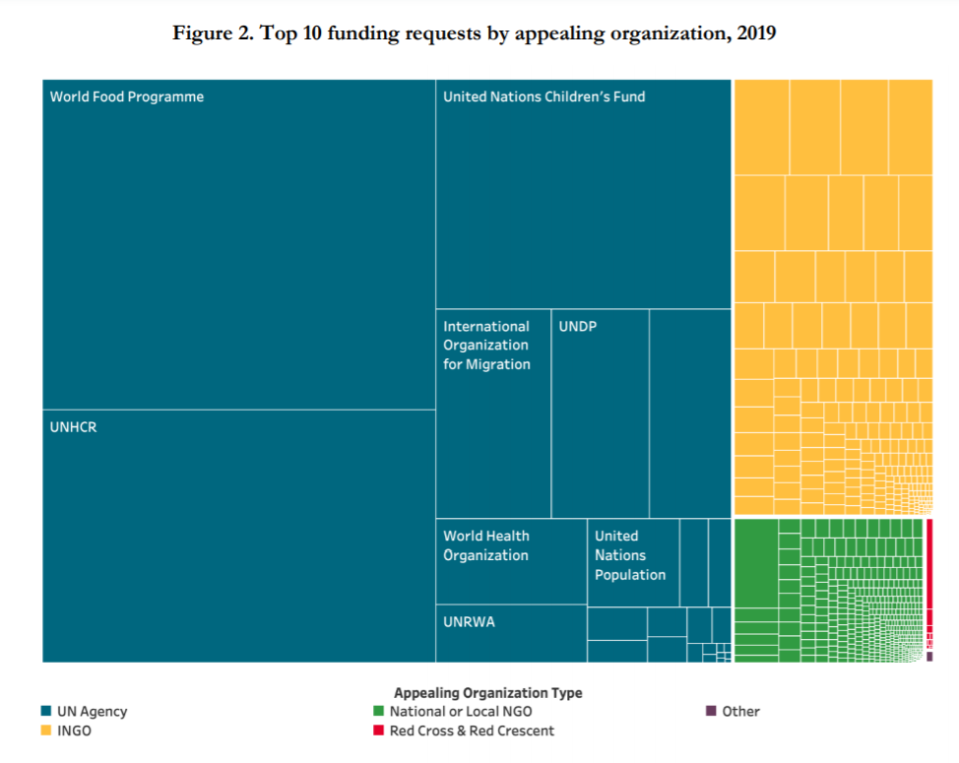
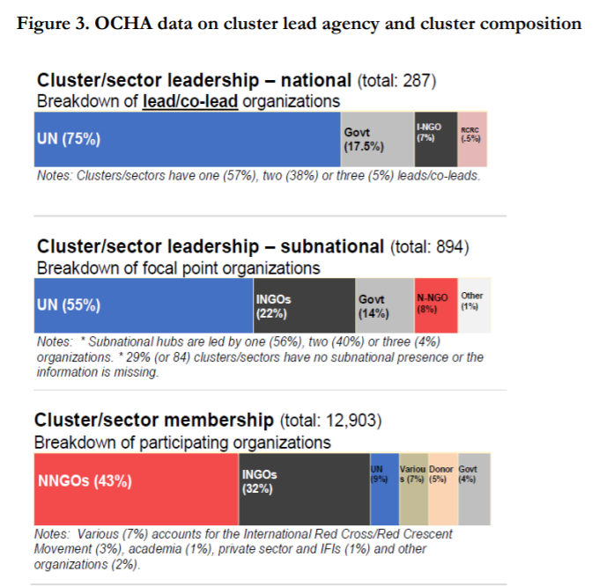
A skewed business model
The clusters concentrate power and funding centrally:

Slide 5
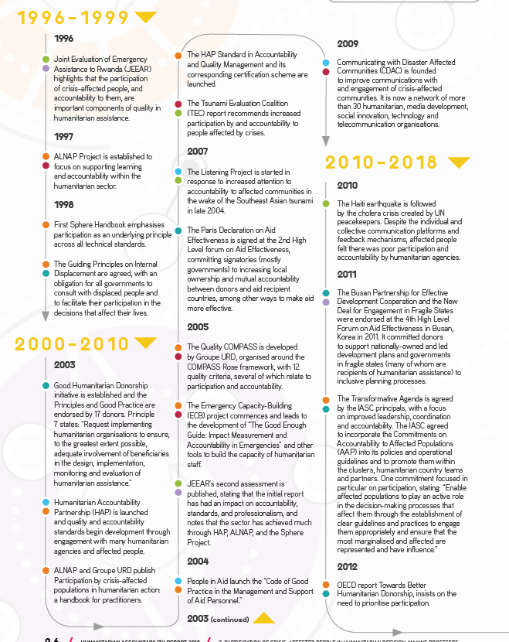
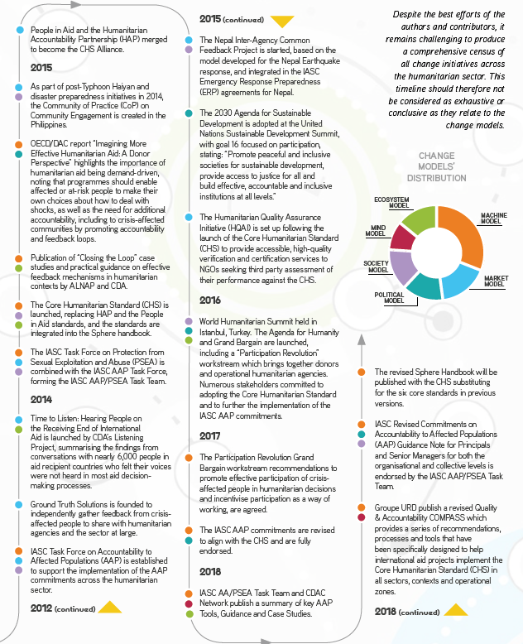
Local Ownership – A Long History…
Timeline of major initiatives and milestones on local participation in humanitarian aid.
(Borrowed from 2018 Humanitarian Accountability Report)

Slide 6
…but limited progress
“the same institutions and actors continue to make the decisions.
Despite the rhetoric and long-standing commitments to change, people affected by crises continue to be far from the centres of power, and not engaged in making the decisions which greatly affect their lives.”
- 2018 Humanitarian Accountability Report
“There remain concerns as to whether signatories will, individually, take the actions to bring about systemic change… [and] also concerns that international organisations need additional resources and incentives from donors to implement more effective participatory methodologies.
- 2018 Independent Grand Bargain Report
“The views of crisis-affected people do not seem, in most cases, to have been influential in creating or changing humanitarian plans.”
“2015-17 did not see any large-scale shift in decision-making power away from humanitarian organisations and toward people affected by crisis.”
- 2018 ALNAP State of the Humanitarian System

Slide 7
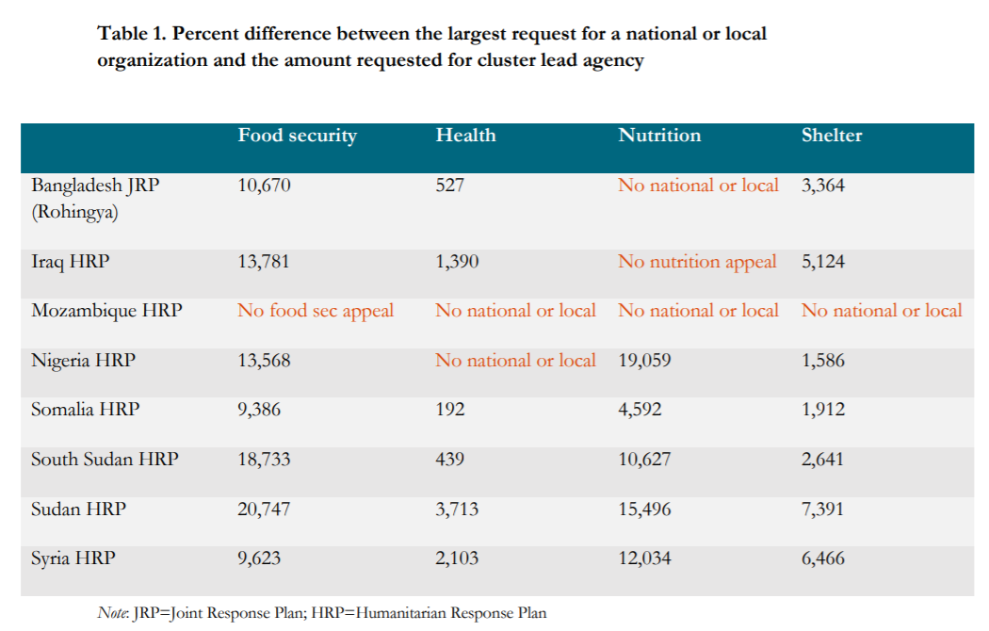
Another way to frame that data:
Cluster inputs to the appeals request thousands to tens-of-thousands percent more for cluster leads agencies than for the largest national partners.

Slide 8
Rethinking the model
Three ideas:
People-driven response
Area-based Coordination
Pooling funds differently
Patrick Saez | December 14, 2020 | CGDev.org

Slide 9
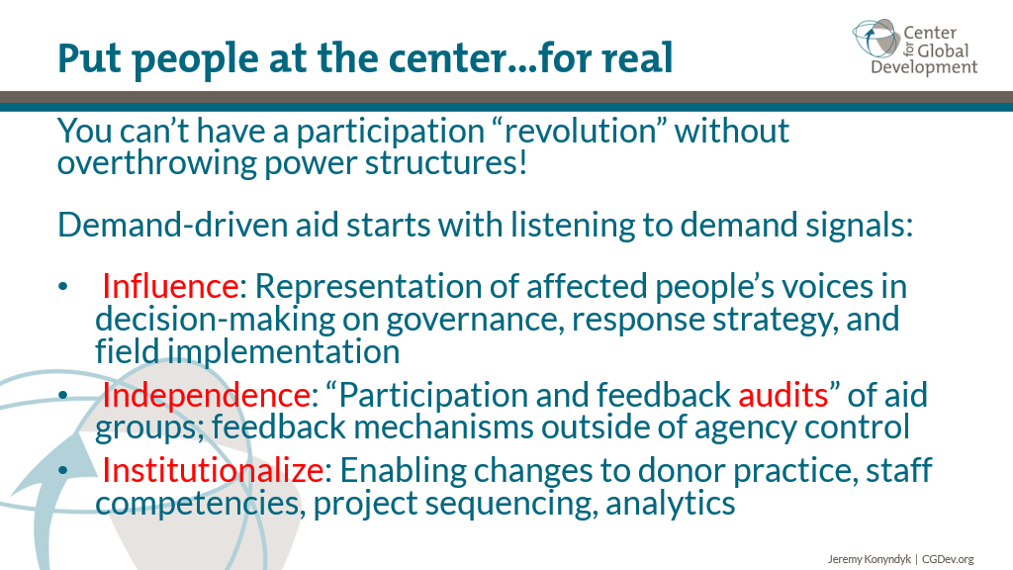
Patrick Saez | December 14, 2020 | CGDev.org

Slide 10
Area-Based Coordination
Area-based approaches are grounded in 3 common elements:
Interventions are organized by community or geography, not sector
Programs are explicitly integrated and multi-sectoral
Direct engagement of affected communities in program design and implementation.
Applying these principles to the humanitarian coordination architecture could address the clusters’ weaknesses…

Slide 11
What would this look like in practice?
Coordinate the humanitarian program cycle (assessment, planning, appeals, implementation) around geography, not sector or mandate
Refocus the clusters on their comparative advantages: technical standards, quality assurance, last-resort gap-filling
Devolve principal responsibility for program cycle coordination to integrated sub-national hubs and antennas
Devolve larger share of funding to sub-national hubs/antennas
Integrate local leaders and civil society fully into program cycle coordination - influence, not just attendance

Slide 12
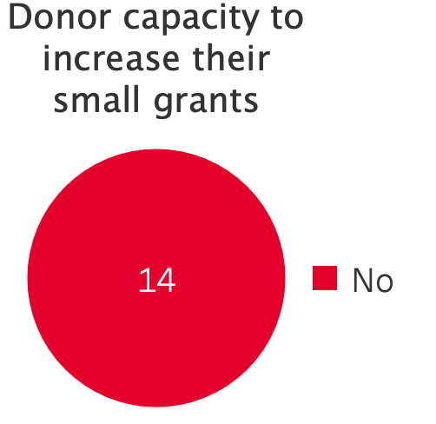
Donors are reliant on intermediaries
Based on survey and interviews

Slide 13
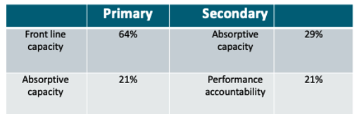
Country-based Pooled Funds
CBPF Primary and Secondary Advantage Capacities
Patrick Saez | December 14, 2020 | CGDev.org

Slide 14
Invert the Pooling Ecosystem
Pooling is inevitable; the current pooling model is not
60%+ of response financing is via UN agencies, acting as de facto pooled funds
Actual pooled funds are ~6% of system funding –mostly fill gaps
Agency pooling is:
earmarked by mandate
less efficient, transparent
more duplicative, fragmented
An alternate model:
Core response funding via crisis-level pooled block grants
Agency-level funding refocused on core activities, not pass-thru
Streamline funding flows: fewer layers & transaction costs
Integrated multi-year, multi-sector programmes
Greater accessibility to frontline & local actors

Slide 15
https://www.cgdev.org/expert/jeremy-konyndyk https://www.cgdev.org/expert/patrick-saez Drop us a line: psaez@cgdev.org jkonyndyk@cgdev.org rworden@cgdev.org

