Slide 1
Bretton Woods in a New World: Navigating the New Economic Landscape Global Economy & Financial Stability Conference, 2024 Masood Ahmed President Emeritus, Center for Global Development

Slide 2
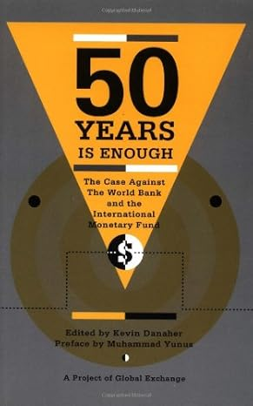

Slide 3
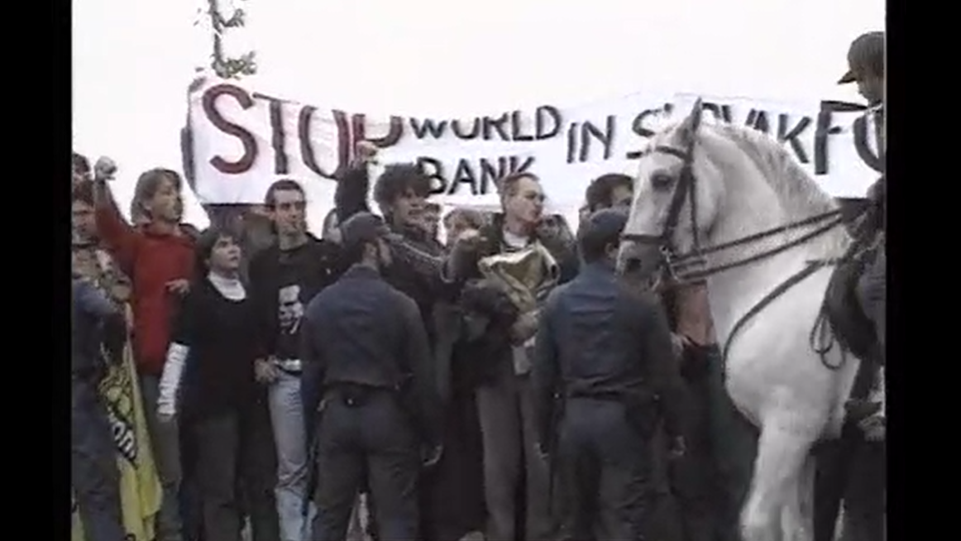
Bretton Woods 50th Anniversary
Madrid, 1994

Slide 4
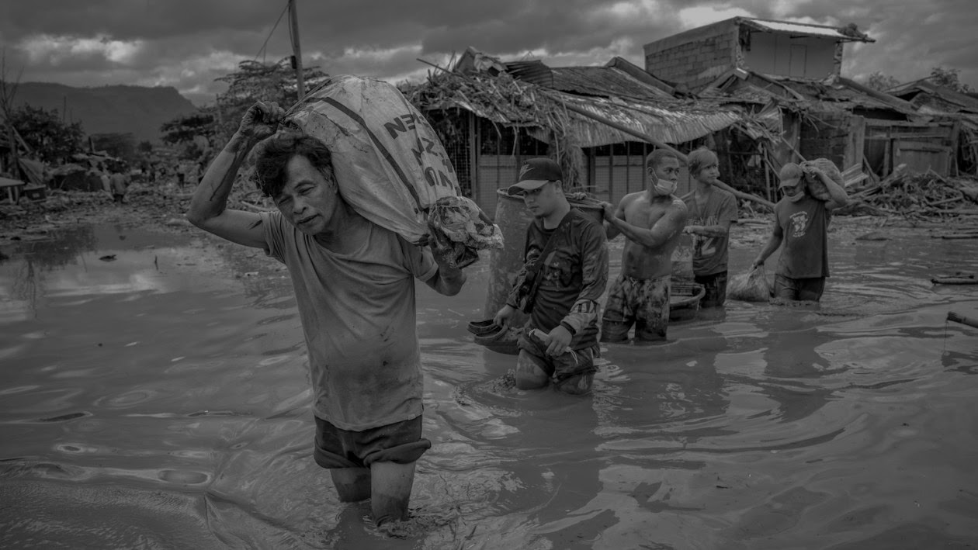
“We are entering a new danger zone — a world that is more fragmented, more fragile, and more prone to shocks that can quickly knock countries off course — often through no fault of their own.”
- Kristalina Georgieva, October 2022
Notes:
1) shocks

Slide 5
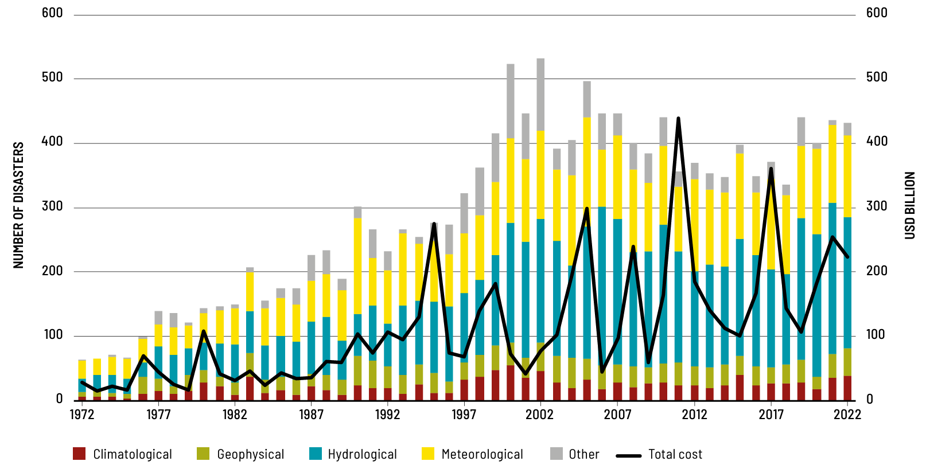
Number of Disasters by Hazard and Economic Loss
Source: UN FAO, EM-DAT Database
Notes:
1) Shocks

Slide 6
Source: IMF, CGD Analysis

Slide 7
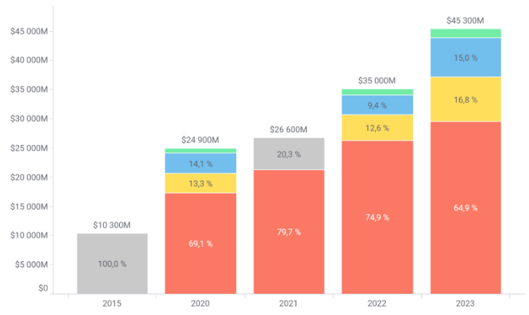
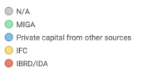
World Bank Total Climate Finance in USD
Source: Bretton Woods Project, World Bank
Source: IMF, CGD Analysis
Notes:
2) Fragility
Climate, fragile states

Slide 8
“Letting the climate effort overshadow the World Bank’s broader objectives would be a grave injustice…”
- Wempi Saputra et al., April 2023
Notes:
Wempi’s piece: https://www.project-syndicate.org/commentary/world-bank-climate-mitigation-efforts-must-not-impede-poverty-reduction-by-wempi-saputra-et-al-2023-04#:~:text=Letting%20the%20climate%20effort%20overshadow,be%20the%20most%20efficient%20strategy.

Slide 9
“…stability will not be achieved by broadening the [IMF’s] remit in an effort to pander to the changing whims of the largest shareholders…”
- Adam Posen, June 2024
Notes:
Posen piece: https://www.imf.org/en/Publications/fandd/issues/2024/06/Geopolitics-Corroding-Globalization-Adam-S-Posen

Slide 10
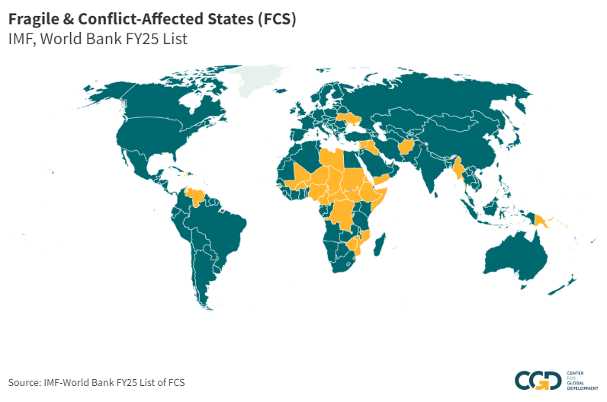

Slide 11
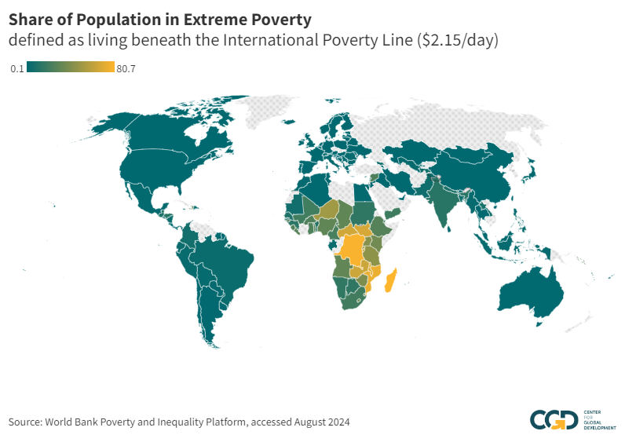

Slide 12
Notes:
2) Fragility

Slide 13
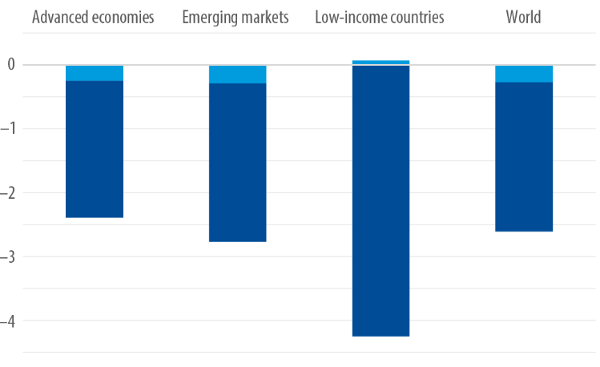
Projected GDP Losses in Two-Bloc World
Source: Marijn Bolhuis et al., “The Costs of Geoeconomic Fragmentation,” Finance & Development, June 2023.

Slide 14
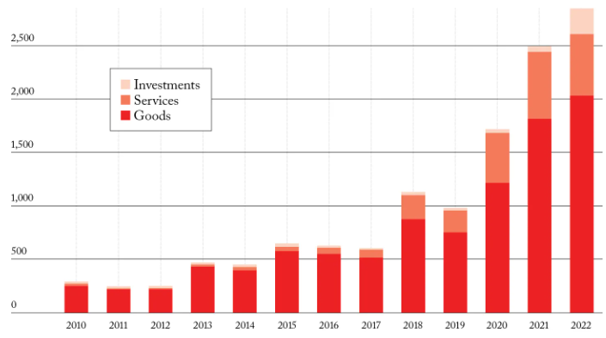
Number of Trade Restrictions Imposed Annually
Source: Kristalina Georgieva, “The Price of Fragmentation,” Foreign Affairs, August 22, 2023.
Notes:
3) Fragmentation

Slide 15
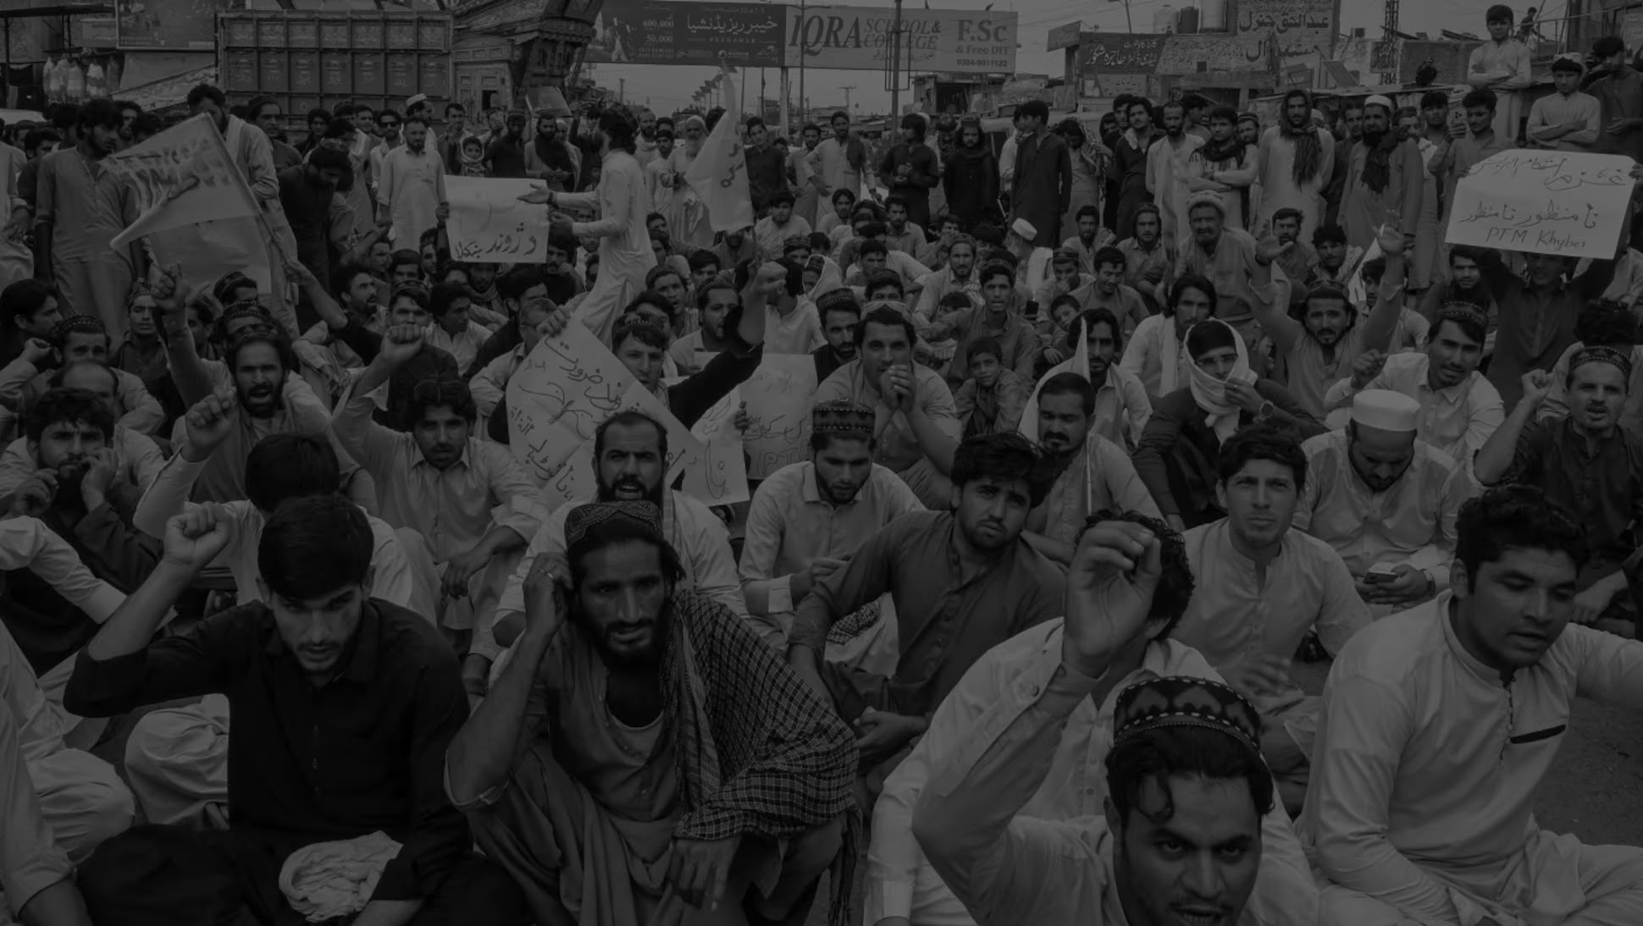
Notes:
5) Social media
Sri Lanka, Ethiopia, Kenya
WB: Bridge program, tribunal

Slide 16
Bretton Woods in a New World: Navigating the New Economic Landscape Global Economy & Financial Stability Conference, 2024 Masood Ahmed President Emeritus, Center for Global Development

