Slide 1
The Economics of Antibiotic Resistance
Anthony McDonnell

Slide 2
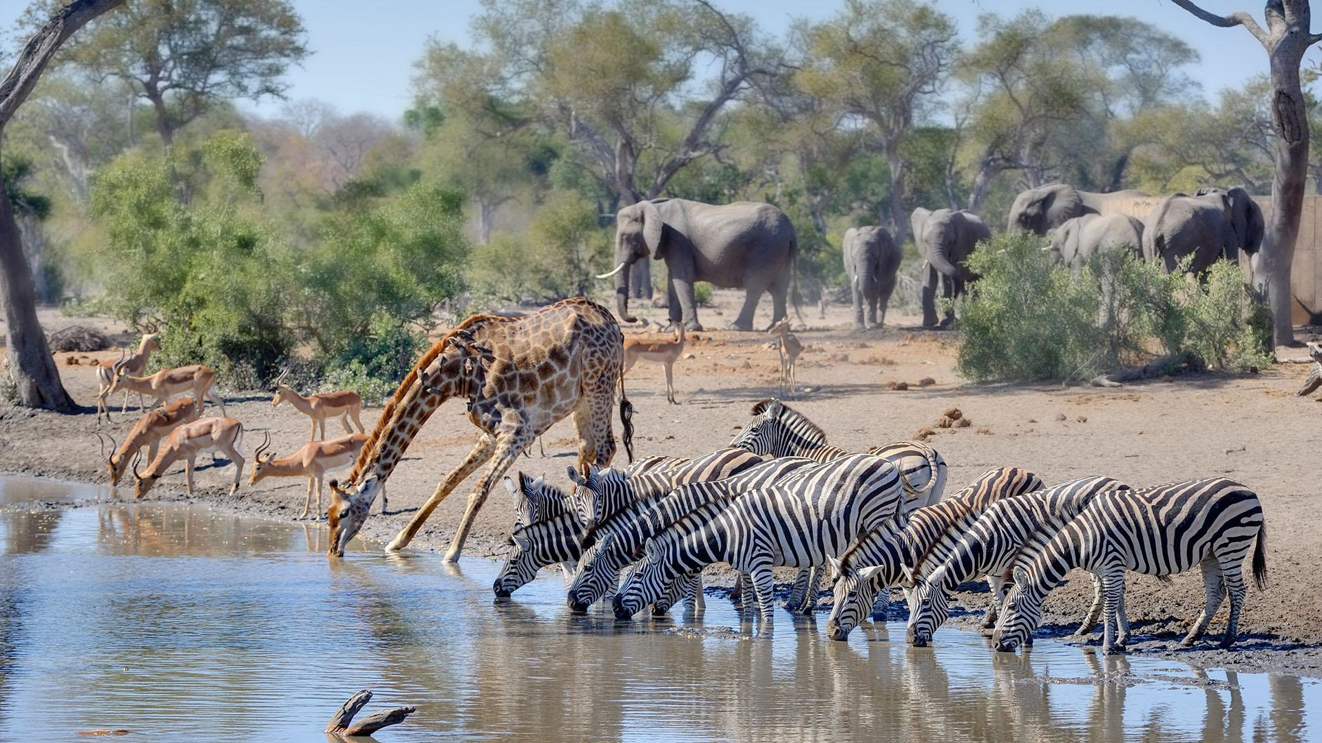
Antibiotics sustain health systems
They have greatly reduced deaths from infections
US infectious disease deaths per 100,000 people
1900 = 797
Late 1930s = 293
Image: Public Broadcasting Service.
1980 = 36
Source: Armstrong et al. Trends in Infectious Disease Mortality in the United States During the 20th Century (1999)

Slide 3
Antibiotics sustain health systems
They have greatly reduced deaths from infections
Allows surgery, transplants, oncology care
Like water, they allow a health system to thrive
Image: Public Broadcasting Service.

Slide 4
Following science requires good economics
“It is not difficult to make microbes resistant to penicillin in the
laboratory by exposing them to concentrations not sufficient to kill them[.]”
Alexander Fleming, 1945
For almost as long as we’ve known about antibiotics, we’ve known about resistance, and how to stop it.
Economic failures undermine our response.
From Baym et al., ‘Spatiotemporal microbial evolution on antibiotic landscapes’, 2016

Slide 5
A common pool problem: Our stock of effective antibiotics is a finite resource for which there is no effective mechanism to moderate demand. The result is a tragedy of the commons: everyone uses antibiotics a little too much, and we will be left with none that work.

Slide 6
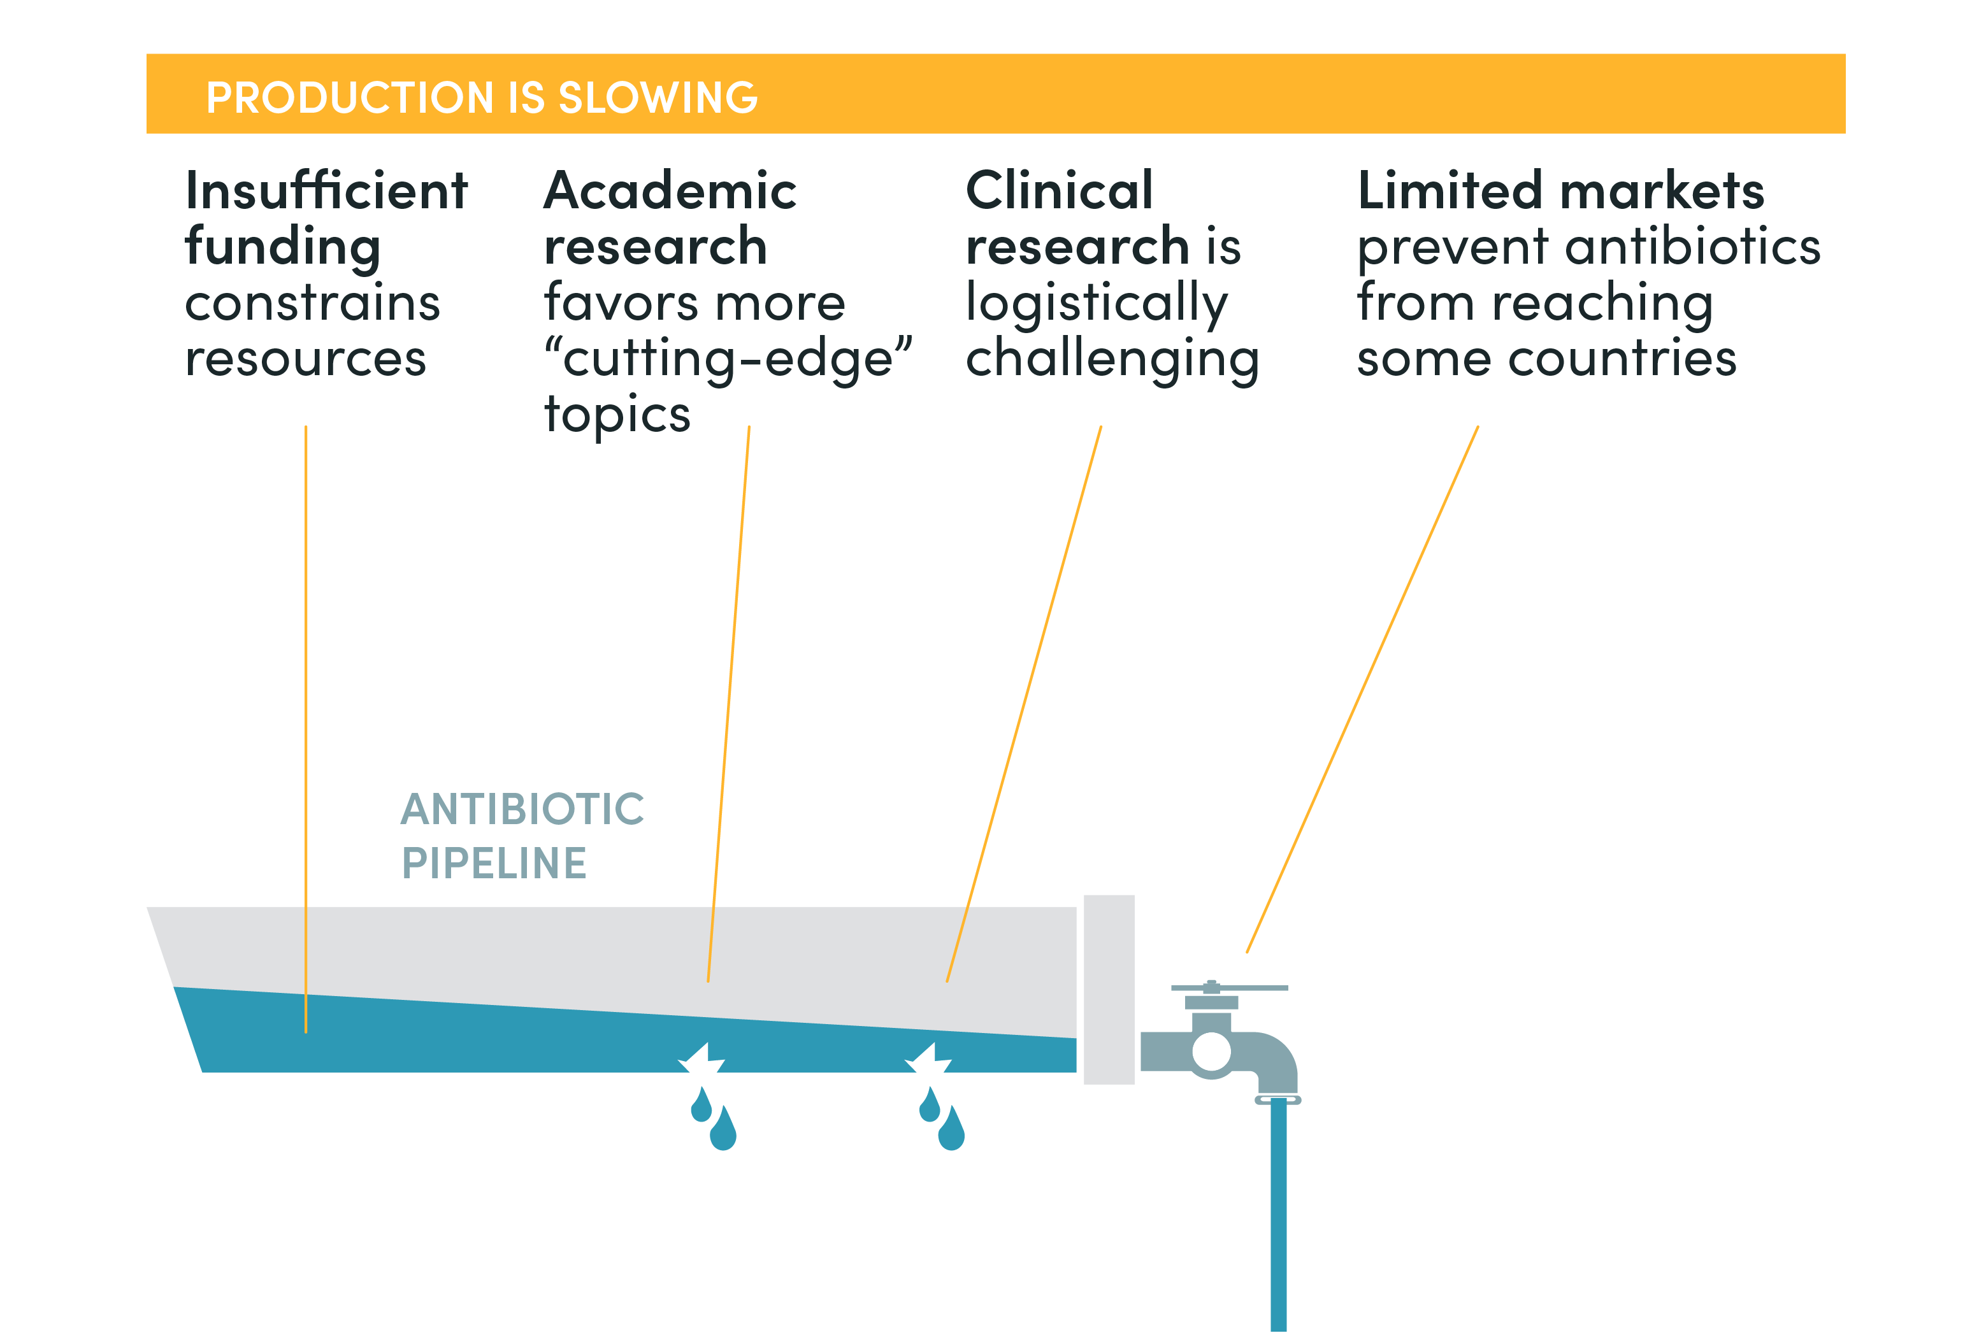

Slide 7
Five failures holding the pipeline back
Antibiotics are public goods (non rivalrous, non-excludable).
The social and private value of new antibiotics are poorly aligned.
Regulatory failures exacerbate these market failures.
Antibiotics have an insurance value that we do not pay for.
Market fails to provide access to treatments.

Slide 8
Four failures causing excessive demand
Infection control is also a public good.
Mismatching problem.
Negative externalities: environmental pollution.
Negative externalities: Antibiotics use in agriculture

Slide 9
Reasons to be optimistic
Through a combination of push and pull funding these pipeline leaks can be solved.
Well designed regulation, taxation can remove most externalities.
Diagnostics and infection control have the potential to greatly reduce resistance.
The amount of money needed for many of these things are small. A new antibiotic probably needs a third as much revenue as the world 200th best selling drug. (Money is necessary but not sufficient to solving this problem.)
Countries have come together to find global solutions to global problems before.

Slide 10
Read the paper to find out more
The Economics of Antibiotic Resistance
Anthony McDonnell, Ranil Dissanayake, Katherine Klemperer, Flavio Toxvaerd, and Michael Sharland
Find it at https://www.cgdev.org/publication/economics-antibiotic-resistance

